Slide 1


Exploring AI & Machine Learning for the Enterprise

Slide 2
What is AI? Introduction

Slide 3
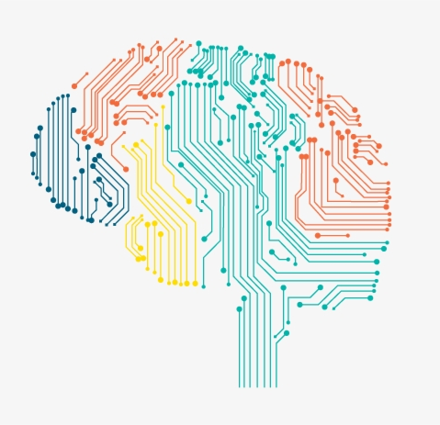

Introduction
AI is creating tremendous amounts of value in every industry
In sectors such as retail, travel, transportation, automotive, materials, manufacturing, healthcare and so on.
Notes:
Welcome back to the course. Data Analytics, AI, Machine Learning… however you want to to view it… it is changing the way we work and live and in this course, we will teach you how to navigate the rise of AI. Whether you want to know what's behind the buzzwords or whether you want to perhaps use AI yourself either in a personal context or in a corporation or other organization, this course will teach you how. If you want to understand how AI is affecting society, and how you can navigate that, you also learn that from this course.We are going to start by cutting through the hype and giving you a realistic view of what Data Science really is. You've probably seen news articles about how much value Data Science is creating. According to a study by McKinsey Global Institute, AI is estimated to create an additional 13 trillion US dollars of value annually by the year 2030.

Slide 4
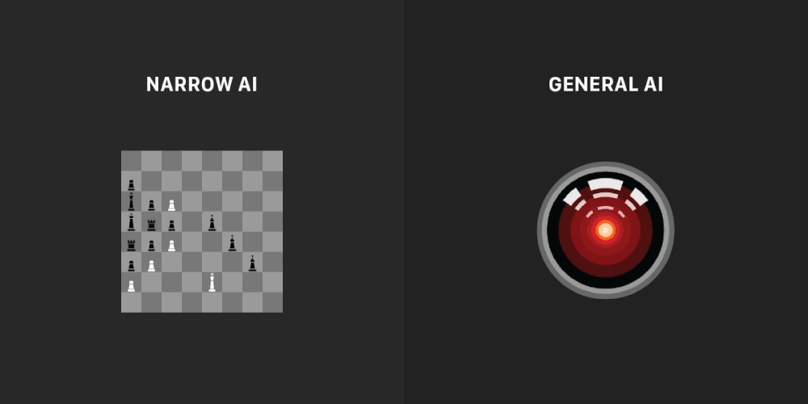
Introduction
Notes:
Can you think of one… any industry that will not be impacted by big data and data science? There is a lot of excitement but also a lot of unnecessary hype about AI. One of the reasons for this is because AI is actually two separate ideas. Almost all the progress we are seeing in the AI today is artificial narrow intelligence. These are AIs that do one thing such as play chess or recommend a book or drive a car. These types of AI are one trick ponies but when you find the appropriate trick, this can be incredibly valuable.
AI also refers to a second concept of AGI or artificial general intelligence. That is the goal to build AI.
They can do anything a human can do or maybe even be superintelligence and do even more things than any human can.
There is a ton of progress in ANI, artificial narrow intelligence and almost no progress to what AGI or artificial general intelligence.

Slide 5

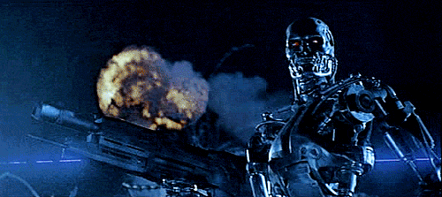

Introduction
AI
ANI
AGI
ASI
Notes:
Artificial Narrow Intelligence and Artificial General Intelligence are all valid research objects and again - there has been a lot of progress in ANI that is incredibly valuable, that has tricked people into thinking that there's a lot of progress in AI, which is only partially true. It is only partially true because again - there has been little progress in AGI and almost none in ASI. Because of this misunderstanding, it has freaked some people out into thinking that there are evil clever robots coming over to take over humanity anytime now. AGI and ASI is an exciting goal for researchers to work on, but it'll take a massive technological breakthroughs before we get there and it may be decades or hundreds of years or even thousands of years away. Given how far away AGI and ASI are, I think there is no need to unduly worry about it. All of the data centric problems that we will study will be in the realm of ANI and what it can do and how you can apply them to your problems. Later in this, course you'll also see some case studies of how ANI, this one trick ponies can be used to build really valuable applications such as smart speakers and self-driving cars. I will also show you how to visualize your data.

Slide 6
What you’ll learn
What is Data Analytics/Data Science
Machine Learning
Data
AI Organizations
What can you really do with this?
Deep Learning
Notes:
In our society, newspapers as well as research papers tend to talk only about the success stories of machine learning and AI and we hardly ever see any failure stories because they just aren't as interesting to report on. But for you to have a realistic view of what AI is and what machine learning can or cannot do, I think it is important that you see examples of both so that you can make more accurate judgements about what you may and maybe should not try to use these technologies for. Finally, a lot of the recent rise of, machine learning has been driven through the rise of Deep Learning, sometimes also called Neural Networks. I also want to give you an intuitive explanation of deep learning so that you will better understand what they can do particularly for a set of narrow ANI tasks. So, that's what you will learn. You will have a sense of DS technologies and what they can and cannot do. You'll learn how these AI technologies can be used to build valuable projects. You will learn how to visualize the data used in these projects. You learn what it feels like to build an AI project as well as what you should do to make sure you select projects that are technically feasible as well as valuable to you or your business or organization. After learning what it takes to build AI projects, you'll learn how to build AI in your company. In particular, if you want to take a few steps toward making your company good at AI, you see the AI transformation playbook and learn how to build AI teams and also built complex Al products

Slide 7
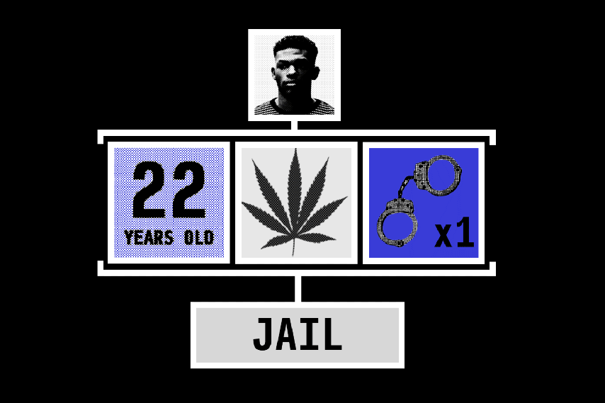
Introduction
Finally, AI is having a huge impact on society. You'll learn about how AI systems can be biased and how to diminish or eliminate such biases.
You also learn how AI is affecting developing economies and how AI is affecting jobs and be better able to navigate this rise of AI for yourself and for your organization.

Slide 8
What is AI? Machine Learning

Slide 9

Introduction
Notes:
By the end of this course, you'll be more knowledgeable and better qualified than even the CEOs of most large companies in terms of your understanding of AI technology as well as your ability to help yourself or your company or other organization navigate the rise of AI as I hope that after this course, you'll be in a position to provide leadership to others as well as they navigate these issues.
Now, one of the major technologies driving the recent rise of AI is Machine Learning.
But what is Machine Learning? Let's take a look in the next slide.

Slide 10
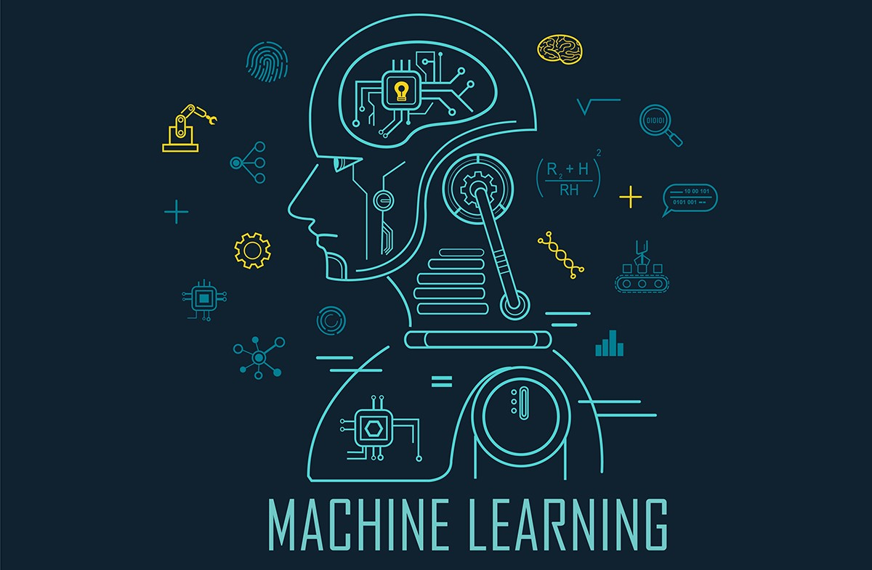
Machine Learning
The rise of AI has been largely driven by one tool in AI:
machine learning.
In this you'll learn what machine learning is, so that by the end, you will start thinking how machine learning might be applied to your role at Johnson and Johnson.

Slide 11

Supervised Learning
A B
Input Output
Notes:
The most commonly used type of machine learning is a type of AI that learns A to B, or input to output mappings. This is called supervised learning.
The data is the input.
The arrow is the model
The output is the prediction (or the information gained from the model and data).

Slide 12
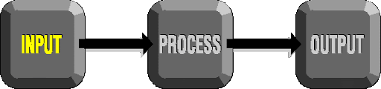
Machine Learning
Input → Process → Output | Use Cases
User Information → MODEL → Click? | Social Media. Online Advertising
email → Model → Spam | Spam Filter
Video → Model → Transcript | Speech Recognition
Shopping History → Model → Offers | Recommender Systems
English → Model → Spanish | Speech Translation
Product Image → Model → Defective | QA
Notes:
If the input A is an email and the output B one is email then the model can determine if it is spam or not, zero or one. Then based on this- this will be used to build the core piece of AI used in a spam filter. Or if the input is a Video, then it is the AI's job to output the text transcript, then this is speech recognition. More examples, if you want to input English and have it output a different language, Chinese, Spanish, something else, then this is machine translation Or the most lucrative form of supervised learning, of this type of machine learning maybe be online advertising, where all the large online ad platforms have a piece of AI that inputs some information about an ad, and some information about you, and tries to figure out, will you click on this ad or not? By showing you the ads you're most likely to click on, this turns out to be very lucrative. Maybe not the most inspiring application, but certainly having a huge economic impact today. Or if you want to build a self-driving car, one of the key pieces of AI is in the AI that takes as input an image, and some information from their radar, or from other sensors, and outputs the position of other cars, so your self-driving car can avoid the other cars. Or in manufacturing. I've actually done a lot of work in manufacturing where you take as input a picture of something you've just manufactured, such as a picture of a cell phone coming off the assembly line. This is a picture of a phone, not a picture taken by a phone, and you want to output, is there a scratch, or is there a dent, or some other defects on this thing you've just manufactured? And this is visual inspection which is helping manufacturers to reduce or prevent defects in the things that they're making. This set of AI called supervised learning, and it just learns input to output, or A to B mappings. On one hand, input to output, A to B it seems quite limiting. But when you find a right application scenario, this can be incredibly valuable. Now, the idea of supervised learning has been around for many decades. But it's really taken off in the last few years. Why is this?

Slide 13
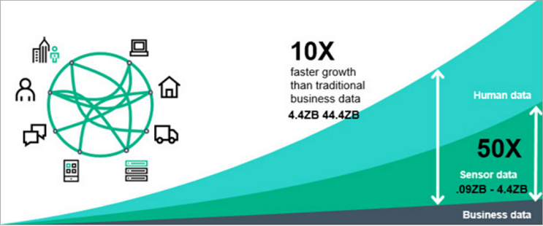
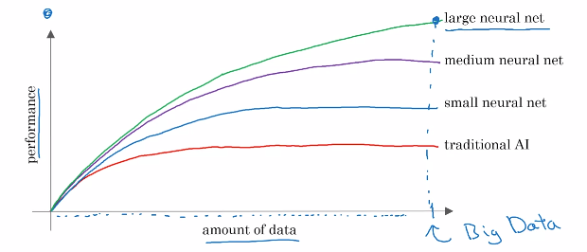
Why Now
Notes:
I want to show you this picture now, and you may be able to draw this picture for others that ask you the same question as well. Let's say on the horizontal axis you plot the amount of data you have for a task. So, for speech recognition, this might be the amount of audio data and transcripts you have. In lot of industries, the amount of data you have access to has really grown over the last couple of decades. Thanks to the rise of the Internet, the rise of computers. A lot of what used to be say pieces of paper, are now instead recorded on a digital computer. So, we've just been getting more and more data. Now, let's say on the vertical axis you plot the performance of an AI system. It turns out that if you use a traditional AI system, then the performance would grow like this, notice that as you feed in more data its performance gets a bit better. But beyond a certain point it did not get that much better. So it's as if your speech recognition system did not get that much more accurate, or your online advertising system didn't get that much more accurate that's showing the most relevant ads, even as you show the more data. AI has really taken off recently due to the rise of neural networks and deep learning. I'll define these terms more precise in later lesson, so don't worry too much about what it means for now. But with modern AI, with neural networks and deep learning, what we saw was that, if you train a small neural network, then the performance looks like this, where as you feed them more data, performance keeps getting better for much longer. If you train a even slightly larger neural network, say medium-sized neural net, then the performance may look like that. If you train a very large neural network, then the performance just keeps on getting better and better
Now, a couple of implications of this figure. If you want the best possible levels of performance, your performance to be up here, to hit this level of performance, then you need two things: One is, it really helps to have a lot of data. So that's why sometimes you hear about big data. Having more data almost always helps. The second thing is, you want to be able to train a very large neural network. So, the rise of fast computers, including Moore's law, but also the rise of specialized processors such as graphics processing units or GPUs, has enabled many companies, not just a giant tech companies, but many other companies to be able to train large neural nets on a large enough amount of data in order to get very good performance and drive business value.

Slide 14
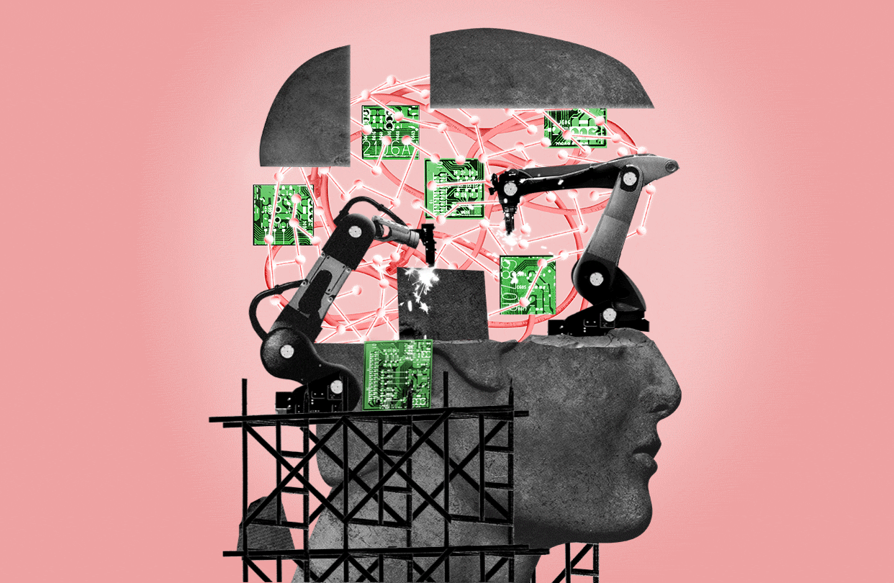
Machine Learning

Slide 15
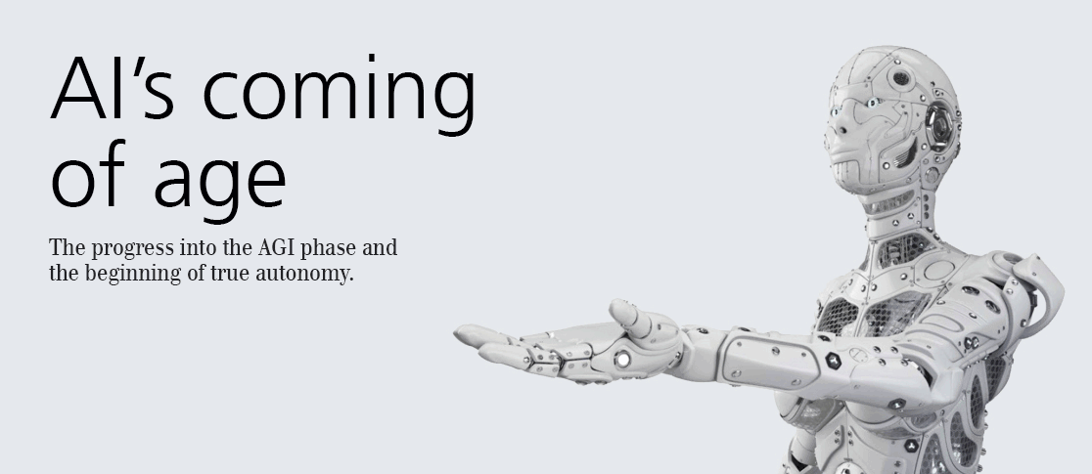
Machine Learning
What enables AI to work really well is data.
Notes:
The most important idea in AI has been machine learning, which is basically supervised learning, which means A to B, or input to output mappings.
In the next slides, let's take a look at what is the data and what data you might already have? And how to think about feeding this into AI systems.

Slide 16
What is AI? What is data?

Slide 17
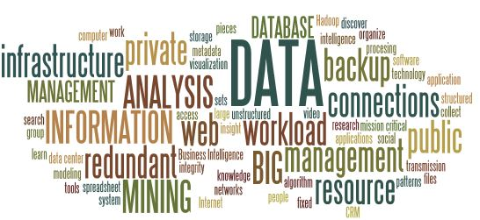
What is data?

Slide 18
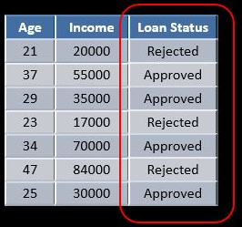
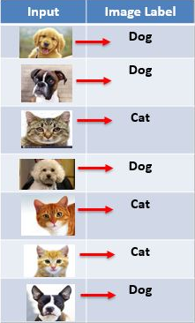
Example of Table Of Data (dataset)
Notes:
You may have heard that data is really important for building AI systems. But, what is data really? Let's take a look. Let's look at an example of a table of data which we also call a dataset. If you're trying to figure out how to price houses that you're trying to buy or sell, you might collect a dataset like this, and this can be just a spreadsheet, like a MS excel spreadsheet of data where one column is the size of the house, say in square feet or square meters, and the second column is the price of the house So, if you're trying to build a AI system or Machine Learning system to help you set prices for houses or figure out if a house is priced appropriately, you might decide that the size of the house is A and the price of the house is B, and have an AI system learn this input to output or A to B mapping. Now, rather than just pricing a house based on their size, you might say, "Well, let's also collect data on the number of bedrooms of this house." In that case, A can be both of these first two columns, and B can be just the price of the house. So, given that table of data, given the dataset, it's actually up to you, up to your business use case to decide what is A and what is B. Data is often unique to your business, and this is an example of a dataset that a rural state agency might have that they tried to help price houses. It's up to you to decide what is A and what is B, and how to choose these definitions of A and B to make it valuable for your business. secondsAs another example, if you have a certain budget and you want to decide what is the size of house you can afford, then you might decide that the input A is how much does someone spend and B is just the size of the house in square feet, and that would be a totally different choice of A and B that tells you, given a certain budget, what's the size of the house you should be maybe looking at. Here's another example of a dataset.
Save Note
Discuss Let's say that you want to build a AI system to recognize cats in pictures. I'm not sure why you might want to do that, but maybe the fun mobile app, and you want to tag all the pictures of cats. So, you might collect a dataset where the input A is a set of different images and the output B are labels that says, "First picture is a cat, that's not a cat. That's a cat, that's not a cat" and have an AI input a picture A and output B is it the cats or not so you can tag all the cat pictures on your photo feed or your mobile app. In Machine Learning tradition, there's actually a lot of cats in Machine Learning. I think some of this started when I was leaving the Google Brain team and we published the results with somewhat infamous Google cat, where an AI system learn to detect cats from watching YouTube videos. But since then, there's been a tradition of using cats as a running example when talking about Machine Learning with apologies to all the dog lovers out there.

Slide 19
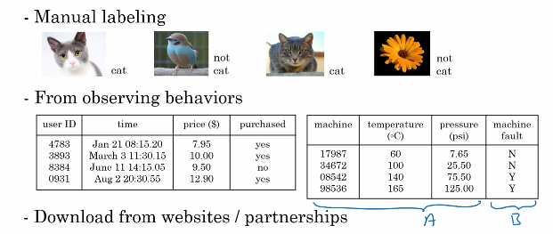
Acquiring Data
Notes:
data is important. But how do you get data? How do you acquire data? Well, one way to get data is manual labeling. For example, you might collect a set of pictures like these over here, and then you might either yourself or have someone else go through these pictures and label each of them. So, the first one is a cat, second one is not a cat, third one is a cat, fourth one is not a cat. By manually labeling each of these images, you now have a dataset for building a cat detector. To do that, you actually need more than four pictures. You might need hundreds of thousands of pictures but manual labeling is a tried and true way of getting a dataset where you have both A and B. Another way to get a dataset is from observing user behaviors or other types of behaviors. So, for example, let's say you run a website that sells things online. So, an e-commerce or an electronic commerce website where you offer things to users at different prices, and you can just observe if they buy your product or not. So, just through the act of either buying or not buying your product, you may be able to collected a data set like this, where you can store the user ID, the time the user visited your website, the price you offer the product to the users as well as whether or not they purchased it. So, just by using your website, users can generate this data from you. This was an example of observing user behaviors. We can also observe behaviors of other things such as machines. If you run a large machine in a factory and you want to predict if a machine is about to fail or have a fault, then just by observing the behavior of a machine, you can then record a dataset like this. There's a machine ID, there's a temperature of the machine, there's a pressure within the machine, and then did the machine fail or not. If your application is prevent the maintenance, say you want to figure out if a machine is about to fail, then you could for example, choose this as the input A and choose that as the output B to try to figure out if a machine is about to fail in which case you might do preventative maintenance on the machine. The third and very common way of acquiring data is to download it from a website or to get it from a partner. Thanks to the open internet, there's just so many, there's as that you can download for free, ranging from computer vision or image datasets, to self-driving car datasets, to speech recognition datasets, to medical imaging data sets to many many more. So, if your application needs a type of data, you just download off the web keeping in mind licensing and copyright, then that could be a great way to get started on the application. Finally, if you're working with a partner, say you're working with a factory, then they may already have collected a big dataset, machines, and temperatures, and pressure into the machines fail not that they could give to you.

Slide 20
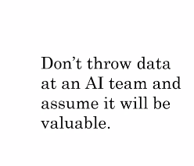
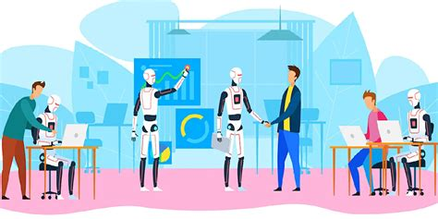
Use and Mis Use Of Data
Notes:
Data is important, but there's also little bit over-hyped and sometimes misused. Let me just describe to you two of the most common misuses or the bad ways of thinking about data. When I speak of seals of large companies, a few of them have even said to me, "Hey Andrew, give me three years to build up my IT team, we're collecting so much data Then after three years, I'll have this perfect dataset, and then we'll do AI then." It turns out that's a really bad strategy. Instead, what I recommend to every company, is once you've started collecting some data, go ahead and start showing it or feeding it to an AI team. Because often, the AI team can give feedback to your IT team on what types of data to collect and what types of IT infrastructure to keep on building For example, maybe an AI team can look at your factory data and say, "Hey. You know what? If you can collect data from this big manufacturing machine, not just once every ten minutes, but instead once every one minute, then we could do a much better job building a preventative maintenance systems for you."
So, there's often this interplay of this back and forth between IT and AI teams, and my advice is usually try to get feedback from AI earlier, because it can help you guide the development of your IT infrastructure. Second, misuse of data. Unfortunately, I've seen some CEOs read about the importance of the trend in use, and then say, "Hey, I have so much data. Surely, an AI team can make it valuable.“Surely, an AI team can make it valuable." Unfortunately, this doesn't always work out. More data is usually better than less data, but I wouldn't take it for granted that just because you have many terabytes or gigabytes of data, that an AI team can actually make that valuable. So, my advice is don't throw data in a AI team and assume it will be valuable. In fact, in one extreme case, I saw one company go and acquire a whole string of other companies in medicine, on the thesis, on the hypothesis the hypothesis that their data would be very valuable. Now, a couple years later, as far as I know the engineers have not yet figured out how to take all this data and actually create value out of it. So, sometimes it works and sometimes it doesn't. But, they will not over-invest in just acquiring data for the sake of data until unless you're also getting an AI team to take a look at it. Because, they can help guide you to think through what is the data that is actually the most valuable.

Slide 21
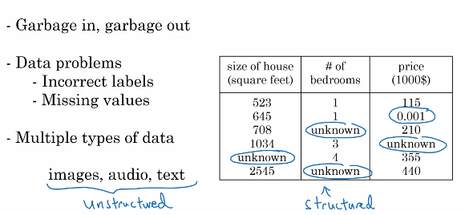
Data is Messy
Notes:
Finally, data is messy. You may have heard the phrase garbage in garbage out, and if you have bad data, then the AI will learn inaccurate things. Here are some examples of data problems. Let's say you have this data sets of size of houses, number of bedrooms, and the price. You can have incorrect labels or just incorrect data. For example, this house is probably not going to sell for $0.1 just for one dollar. Or, data can also have missing values such as we have here a whole bunch of unknown values. So, your AI team will need to figure out how to clean up the data or how to deal with these incorrect labels and all missing values. There are also multiple types of data. For example, sometimes you hear about images, audio, and text. These are types of data that humans find it very easy to interpret. There's a term for this. This is called unstructured data, and there's a certain types of AI techniques that could work with images to recognize cats or audios to recognize speech or texts, or understand that email is spam. Then, there are also datasets like the one on the right. This is an example of structured data. That basically means data that lives in a giant spreadsheet, and the techniques for dealing with unstructured data are little bit different than the techniques for dealing with structured data. But AI techniques can work very well for both of these types of data, unstructured data and structured data.

Slide 22
What is data?
In this you learned what is data and you also saw how not to misuse data.
Finally, you saw data is messy. But a good AI team would be the help you deal with all of these problems.
Now, AI has a complicated terminology when people start throwing around terms like AI, Machine Learning, Data Science.
Notes:
What I want to do in the next is share with you what these terms actually mean, so that you'd be able to confidently and accurately talk about these concepts with others. Let's go on to the next slides.
In this you learned what is data and you also saw how not to misuse data, for example by over-investing in an IT infrastructure in the hope that it will be useful for AI in the future, but we're actually checking that they're really will be useful for the AI applications you want to build.
Finally, you saw data is messy. But a good AI team would be the help you deal with all of these problems.
Now, AI has a complicated terminology when people throw around terms like AI, Machine Learning, Data Science.

Slide 23
What is AI? The terminology of AI

Slide 24
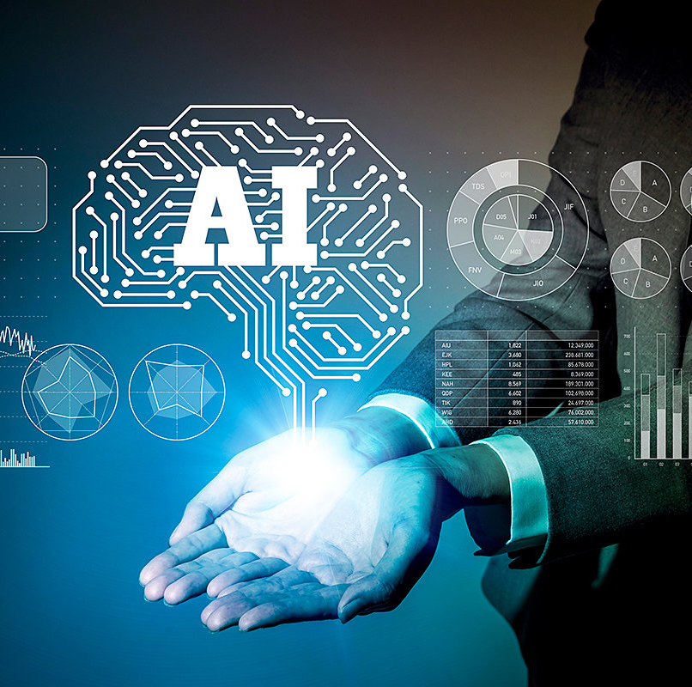
The terminology of AI
You might have heard terminology from AI, such as machine learning or data science or neural networks or deep learning. What do these terms mean?
In this, you'll see what is this terminology of the most important concepts of AI, so that you will speak with others about it and start thinking how these things could apply in your business.

Slide 25
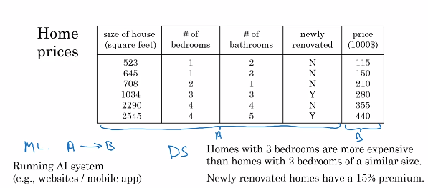
Machine Learning vs. Data Science
Notes:
Let's get started. Let's say you have a housing dataset like this with the size of the house, number of bedrooms, number of bathrooms, whether the house is newly renovated as was the price. If you want to build a mobile app to help people price houses, so this would be the input A, and this would be the output B. Then, this would be a machine-learning system, and particular would be one of those machine learning systems that learns inputs to outputs, or A to B mappings. So, machine learning often results in a running AI system. So, it's a piece of software that anytime of day, anytime of night you can automatically input A these properties of house and output B. So, if you have an AI system running, serving dozens or hundreds of thousands of millions of users, that's usually a machine-learning system. In contrast, here's something else you might want to do, which is to have a team analyze your dataset in order to gain insights. So, a team might come up with a conclusion like, "Hey, did you know if you have two houses of a similar size, they've a similar square footage, if the house has three bedrooms, then they cost a lot more than the house of two bedrooms, even if the square for this is the same." Or, "Did you know that newly renovated homes have a 15% premium, and this can help you make decisions such as, given a similar square footage, do you want to build a two bedroom or three bedroom size in order to maximize value? Or, "Is it worth an investment to renovate a home in the hope that the renovation increases the price you can sell a house for?" So, these would be examples of data science projects, where the output of a data science project is a set of insights that can help you make business decisions, such as what type of house to build or whether to invest in renovation. The boundaries between these two terms, machine learning and data science are actually little bit buzzy, and these terms are not used consistently even in industry today. But what I'm giving here is maybe the most commonly used definitions of these terms, but you will not find universal adherence to these definitions.

Slide 26
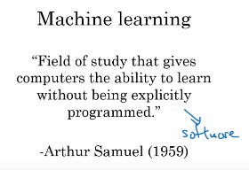
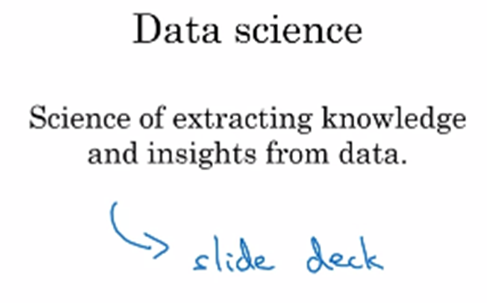
Machine Learning vs.Data Science
Notes:
To formalize these two notions a bit more, machine learning is the field of study that gives computers the ability to learn without being explicitly programmed. This is a definition by Arthur Samuel many decades ago. Arthur Samuel was one of the pioneers of machine learning, who was famous for building a checkers playing program. They could play checkers, even better than he himself, the inventor could play the game. So, a machine learning project will often results in a piece of software that runs, that outputs B given A. In contrast, data science is the size of extracting knowledge and insights from data. So, the output of a data science project is often a slide deck, the PowerPoint presentation that summarizes conclusions for executives to take business actions or that summarizes conclusions for a product team to decide how to improve a website

Slide 27

The terminology of AI
Notes:
Let me give an example of machine learning versus data science in the online advertising industry.
Today, to launch our platforms, all have a piece of AI that quickly tells them what's the ad you are most likely to click on. So, that's a machine learning system.
This turns out to be incredibly lucrative AI system to inputs enrich about you and about the ad and outputs where you click on this or not.
These systems are running 24-7. These are machine learning systems that drive our gravity for these companies, such as a piece of software that runs. In contrast, I have also done data science projects in the online advertising industry. If analyzing data tells you, for example, that the travel industry is not buying a lot of ads, but if you send more salespeople to sell ads to travel companies, you could convince them to use more advertising, then that would be an example of a data science project and the data science conclusion the results and the executives deciding to ask a sales team to spend more time reaching out to the travel industry

Slide 28
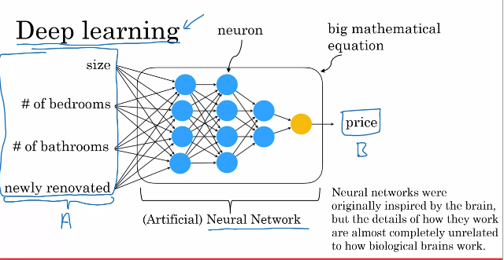
Deep Learning
Notes:
even in one company, you may have different machine learning and data science projects, both of which can be incredibly valuable. You have also heard of deep learning. So, what is deep learning? Let's say you want to predict housing prices, you want to price houses. So, you will have an input that tells you the size of the house, number of bedrooms, number of bathrooms and whether it's newly renovated. One of the most effective ways to price houses, given this input A would be to feed it to this thing here in order to have it output the price.
This big thing in the middle is called a neural network, and sometimes we also called an artificial neural network. That's to distinguish it from the neural network that is in your brain. So, the human brain is made up of neurons. So, when we say artificial neural network, that's just to emphasize that this is not the biological brain, but this is a piece of software. What a neural network does, or an artificial neural network does is takes this input A, which is all of these four things, and then output B, which is the estimated price of the house. Now, in a later optional lesson, I'll show you more, what this artificial neural network really is. But all of human cognition is made up of neurons in your brain passing electrical impulses, passing little messages each other. When we draw a picture of an artificial neural network, there's a very loose analogy to the brain. These little circles are called artificial neurons, or just neurons for short. That also passes neurons to each other. This big artificial neural network is just a big mathematical equation that tells it given the inputs A, how do you compute the price B. In case it seems like there a lot of details here, don't worry about it. We'll talk more about these details later. But the key takeaways are that a neural network is a very effective technique for learning A to B or input-output mappings. Today, the terms neural network and deep learning are used almost interchangeably, they mean essentially the same thing. Many decades ago, this type of software was called a neural network. But in recent years, we found that deep learning was just a much better sounding brand, and so that for better or worse is a term that's been taken off recently. So, what do neural networks or artificial neural networks have to do with the brain? It turns out almost nothing. Neural networks were originally inspired by the brain, but the details of how they work are almost completely unrelated to how biological brains work. So, I choose very courses today about making any analogies between artificial neural networks and the biological brain, even though there was some loose inspiration there.

Slide 29
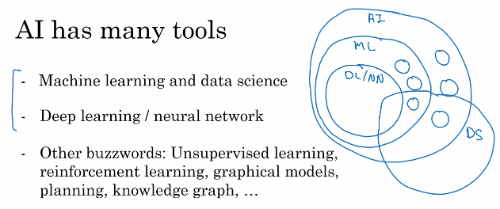
The terminology of AI
Notes:
So, AI has many different tools. In this lesson, you learned about what are machine learning and data science, and also what is deep learning, and what's a neural network. You might also hear in the media other buzzwords like unsupervised learning, reinforcement learning, graphical models, planning, knowledge graph, and so on. You don't need to know what all of these other terms mean, but these are just other tools to getting AI systems to make computers act intelligently. I'll try to give you a sense of what some of these terms mean in later videos as well. But the most important tools that I hope you know about are machine learning and data science as well as deep learning and neural networks, which are a very powerful way to do machine learning, and sometimes data science. If we were to draw a Venn diagram showing how all these concepts put together, this is what it may look like. AI is this huge set of tools for making computers behave intelligently. Off AI, the biggest subset is prairie tools from machine learning, but AI does have other tools than machine learning, such as some of these buzzwords, are listed at the bottom. The part of machine learning that's most important these days is neural networks or deep learning, which is a very powerful set of tools for carrying out supervised learning or A to B mappings as well as some other things. But there are also other machine learning tools that are not just deep learning tools. So, how does data science fit into this picture? There is inconsistency in how the terminology is used. Some people will tell you data science is a subset of AI. Some people will tell you AI is a subset of data science. So, it depends on who you ask. But I would say that data science is maybe a cross-cutting subset of all of these tools that uses many tools from AI machine learning and deep learning, but has some other separate tools as well that solves a very set of important problems in driving business insights.

Slide 30
The terminology of AI
In this lesson, you saw what is machine learning, what is data science, and what is deep learning and neural networks.
I hope this gives you a sense of the most common and important terminology using AI, and you can start thinking about how these things might apply to your company.
Now, what does it mean for a company to be good at AI? Let's talk about that in the next slides.

Slide 31
What is AI? What makes an AI company?

Slide 32
What makes an AI company?
What makes a company good at AI? Perhaps even more importantly, what will it take for your company to become great at using AI?
So, what can you do for your company?
This is the lesson I had learned by watching the rise of the Internet that I think will be relevant to how all of us navigate the rise of AI.

Slide 33
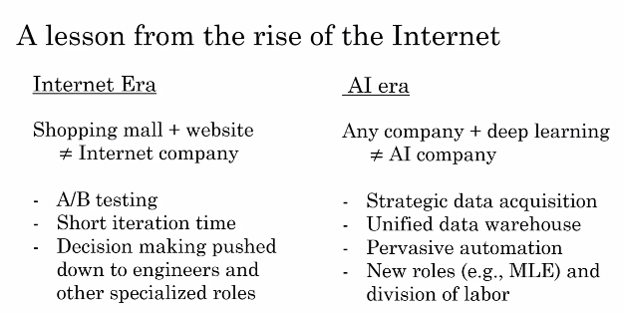
What makes an AI company?
Notes:
A lesson we learned from the rise of the Internet was that, if you take your favorite shopping mall. So, my wife and I sometimes shop at Stanford shopping center and you build a website for the Shopping mall. Maybe sell things on the website, that by itself does not turn the shopping mall into an internet company. In fact, a few years ago I was speaking with the CEO of a large retail company who said to me, "Hey Andrew, I have a website, I sell things in the website." Amazon has a website, Amazon sells things on website is the same thing. But of course it wasn't, in the shopping mall with a website isn't the same thing as a first-class internet company. So, what is it that defines an internet company if it isn't just whether or not you sell things on the website? I think an Internet company is a company that does the thing that internet let you do really well. For example, we engage and pervasive AB testing. Meaning we routinely threw up two different versions of website and see which one works better because we can. So, we learn much faster. Whereas in a traditional shopping mall, very difficult to have two shopping malls in two parallel universes and you can only maybe change things around every quarter or every six months. Internet company is since a very short iteration times. You can ship a new product every week or maybe even every day because you can whereas a shopping mall can be redesigned and we are protected only every several months. Internet companies also tend to push decision-making down from the CEO to the engineers and to other specialized rules such that the product managers. This is in contrast to a traditional shopping mall. We can maybe have the CEO just decide all the key decisions and then just everyone does what the CEO says. just everyone does what the CEO says. It turns out that traditional model doesn't work in the internet era because only the engineers and other specialized roles like product managers know enough about the technology and the product and the users to make great decisions. So, these are some of the things that internet companies do in order to make sure they do the things that the internet doesn't do really well. This is a lesson we learned from the internet era. How about the AI era?
I think that today, you can take any company and have it use a few neural networks or few deep learning algorithms. That by itself does not turn the accompany into an AI company. Instead, what makes a great AI company, sometimes an AI first company is, are you doing the things that AI lets you do really well? For example, AI companies are very good at strategic data acquisition This is why many of the large consumer tech companies may have three products that do not monetize and it allows them to acquire data that they can monetize elsewhere. Serve less strategy teams where we would deliberately launch products that do not make any money just for the sake of data acquisition. Thinking through how to get data is a key part of the great AI companies. AI companies sends a unified data warehouses. If you have 50 different databases or 50 different data warehouses under the control of 50 different Vice-Presidents, then there will be impossible for an engineer to get the data into one place so that they can connect the dots and spot the patterns. So, many great AI companies have preemptively invested in bringing the data together into single data warehouse to increase the odds that the teams can connect the dots. Subject of course to privacy guarantees and also to data regulations such as GDPR in Europe. AI companies are very good at spotting automation opportunities. We're very good at saying, Oh! Let's insert the supervised learning algorithm and have an ATP mapping here so that we don't have to have people do these tasks instead we can automate It. AI companies also have many new roles such as the MLE or Machine Learning Engineer and new ways of dividing up tasks among different members of a team. So, for a company to become good at AI means, architecting for company to do the things that AI makes it possible to do really well. Now, for a company that become good at AI does require a process. In fact, 10 years ago, Google and Baidu as well as companies like Facebook and Microsoft that I was not a part of, we're not great AI companies the way they are today. So, how can a company become good at AI? So, how can a company become good at AI? It turns out that becoming good at AI is not a mysterious magical process. Instead there is a systematic process through which many companies, almost any big company can become good at AI. This is the five-step AI transformation playbook that I recommend to companies that want to become effective at using AI. I'll give a brief overview of the playbook here and they're going to detail in a later week.

Slide 34
What makes an AI company?
Notes:
A lesson we learned from the rise of the Internet was that, if you take your favorite shopping mall. So, my wife and I sometimes shop at Stanford shopping center and you build a website for the Shopping mall. Maybe sell things on the website, that by itself does not turn the shopping mall into an internet company. In fact, a few years ago I was speaking with the CEO of a large retail company who said to me, "Hey Andrew, I have a website, I sell things in the website." Amazon has a website, Amazon sells things on website is the same thing. But of course it wasn't, in the shopping mall with a website isn't the same thing as a first-class internet company. So, what is it that defines an internet company if it isn't just whether or not you sell things on the website? I think an Internet company is a company that does the thing that internet let you do really well. For example, we engage and pervasive AB testing. Meaning we routinely threw up two different versions of website and see which one works better because we can. So, we learn much faster. Whereas in a traditional shopping mall, very difficult to have two shopping malls in two parallel universes and you can only maybe change things around every quarter or every six months. Internet company is since a very short iteration times. You can ship a new product every week or maybe even every day because you can whereas a shopping mall can be redesigned and we are protected only every several months. Internet companies also tend to push decision-making down from the CEO to the engineers and to other specialized rules such that the product managers. This is in contrast to a traditional shopping mall. We can maybe have the CEO just decide all the key decisions and then just everyone does what the CEO says. just everyone does what the CEO says. It turns out that traditional model doesn't work in the internet era because only the engineers and other specialized roles like product managers know enough about the technology and the product and the users to make great decisions. So, these are some of the things that internet companies do in order to make sure they do the things that the internet doesn't do really well. This is a lesson we learned from the internet era. How about the AI era?
I think that today, you can take any company and have it use a few neural networks or few deep learning algorithms. That by itself does not turn the accompany into an AI company. Instead, what makes a great AI company, sometimes an AI first company is, are you doing the things that AI lets you do really well? For example, AI companies are very good at strategic data acquisition This is why many of the large consumer tech companies may have three products that do not monetize and it allows them to acquire data that they can monetize elsewhere. Serve less strategy teams where we would deliberately launch products that do not make any money just for the sake of data acquisition. Thinking through how to get data is a key part of the great AI companies. AI companies sends a unified data warehouses. If you have 50 different databases or 50 different data warehouses under the control of 50 different Vice-Presidents, then there will be impossible for an engineer to get the data into one place so that they can connect the dots and spot the patterns. So, many great AI companies have preemptively invested in bringing the data together into single data warehouse to increase the odds that the teams can connect the dots. Subject of course to privacy guarantees and also to data regulations such as GDPR in Europe. AI companies are very good at spotting automation opportunities. We're very good at saying, Oh! Let's insert the supervised learning algorithm and have an ATP mapping here so that we don't have to have people do these tasks instead we can automate It. AI companies also have many new roles such as the MLE or Machine Learning Engineer and new ways of dividing up tasks among different members of a team. So, for a company to become good at AI means, architecting for company to do the things that AI makes it possible to do really well. Now, for a company that become good at AI does require a process. In fact, 10 years ago, Google and Baidu as well as companies like Facebook and Microsoft that I was not a part of, we're not great AI companies the way they are today. So, how can a company become good at AI? So, how can a company become good at AI? It turns out that becoming good at AI is not a mysterious magical process. Instead there is a systematic process through which many companies, almost any big company can become good at AI. This is the five-step AI transformation playbook that I recommend to companies that want to become effective at using AI. I'll give a brief overview of the playbook here and they're going to detail in a later week.

Slide 35
What makes an AI company?
Notes:
A lesson we learned from the rise of the Internet was that, if you take your favorite shopping mall. So, my wife and I sometimes shop at Stanford shopping center and you build a website for the Shopping mall. Maybe sell things on the website, that by itself does not turn the shopping mall into an internet company. In fact, a few years ago I was speaking with the CEO of a large retail company who said to me, "Hey Andrew, I have a website, I sell things in the website." Amazon has a website, Amazon sells things on website is the same thing. But of course it wasn't, in the shopping mall with a website isn't the same thing as a first-class internet company. So, what is it that defines an internet company if it isn't just whether or not you sell things on the website? I think an Internet company is a company that does the thing that internet let you do really well. For example, we engage and pervasive AB testing. Meaning we routinely threw up two different versions of website and see which one works better because we can. So, we learn much faster. Whereas in a traditional shopping mall, very difficult to have two shopping malls in two parallel universes and you can only maybe change things around every quarter or every six months. Internet company is since a very short iteration times. You can ship a new product every week or maybe even every day because you can whereas a shopping mall can be redesigned and we are protected only every several months. Internet companies also tend to push decision-making down from the CEO to the engineers and to other specialized rules such that the product managers. This is in contrast to a traditional shopping mall. We can maybe have the CEO just decide all the key decisions and then just everyone does what the CEO says. just everyone does what the CEO says. It turns out that traditional model doesn't work in the internet era because only the engineers and other specialized roles like product managers know enough about the technology and the product and the users to make great decisions. So, these are some of the things that internet companies do in order to make sure they do the things that the internet doesn't do really well. This is a lesson we learned from the internet era. How about the AI era?
I think that today, you can take any company and have it use a few neural networks or few deep learning algorithms. That by itself does not turn the accompany into an AI company. Instead, what makes a great AI company, sometimes an AI first company is, are you doing the things that AI lets you do really well? For example, AI companies are very good at strategic data acquisition This is why many of the large consumer tech companies may have three products that do not monetize and it allows them to acquire data that they can monetize elsewhere. Serve less strategy teams where we would deliberately launch products that do not make any money just for the sake of data acquisition. Thinking through how to get data is a key part of the great AI companies. AI companies sends a unified data warehouses. If you have 50 different databases or 50 different data warehouses under the control of 50 different Vice-Presidents, then there will be impossible for an engineer to get the data into one place so that they can connect the dots and spot the patterns. So, many great AI companies have preemptively invested in bringing the data together into single data warehouse to increase the odds that the teams can connect the dots. Subject of course to privacy guarantees and also to data regulations such as GDPR in Europe. AI companies are very good at spotting automation opportunities. We're very good at saying, Oh! Let's insert the supervised learning algorithm and have an ATP mapping here so that we don't have to have people do these tasks instead we can automate It. AI companies also have many new roles such as the MLE or Machine Learning Engineer and new ways of dividing up tasks among different members of a team. So, for a company to become good at AI means, architecting for company to do the things that AI makes it possible to do really well. Now, for a company that become good at AI does require a process. In fact, 10 years ago, Google and Baidu as well as companies like Facebook and Microsoft that I was not a part of, we're not great AI companies the way they are today. So, how can a company become good at AI? So, how can a company become good at AI? It turns out that becoming good at AI is not a mysterious magical process. Instead there is a systematic process through which many companies, almost any big company can become good at AI. This is the five-step AI transformation playbook that I recommend to companies that want to become effective at using AI. I'll give a brief overview of the playbook here and they're going to detail in a later week.

Slide 36
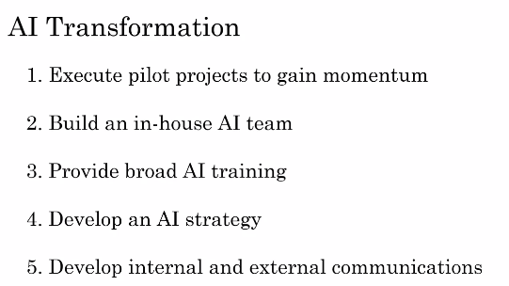
What makes an AI company?
Notes:
Step one is to execute pilot projects to gain momentum. So, just to a few small projects to get a better sense of what AI can or cannot do and get a better sense of what doing an AI project feels like. This you could do in house or you can also do with an outsource team. But eventually, you then need to do step two which is the building in house AI team and provide broad AI training, not just to the engineers but also to the managers, division leaders and executives and how they think about AI. After doing this or as you're doing this, you have a better sense of what AI is and then is important for many companies to develop an AI strategy. Finally, to align internal and external communications so that all your stakeholders from employees, customers and investors are aligns with how your company is navigating the rise of AI.
AI has created tremendous value in the software industry and will continue to do so.
If you can help your company become good at AI, I hope you can play a leading role in creating a lot of this value.

Slide 37
What makes an AI company?
AI has created tremendous value in the software industry and will continue to do so.
If you can help your company become good at AI, I hope you can play a leading role in creating a lot of this value.
It is slides you saw what is it that makes a company a good AI company and also briefly the AI transformation playbook which I'll go into much greater detail on in a later lesson as a road-map for helping companies become great at AI.
Notes:
If you're interested, there is also published online an AI transformation playbook that goes into these five steps in greater detail for you see more of these in the later as well. Now, one of the challenges of doing AI projects such as the pilot projects in step one is understanding what AI can and cannot do.

Slide 38
What makes an AI company?
In the next slides, I want to show you and give you some examples of what AI can and cannot do, to help you better select projects AI that there may be effective for your company.
Notes:
That's gone to the next slide

Slide 39
What is AI? What machine learning can and cannot do

Slide 40
What machine learning can and cannot do
In these slides and the next slides, I hope to help you develop intuition about what AI can and cannot do. In practice, before I commit to a specific AI project, I'll usually have either myself or engineers do technical diligence on the project to make sure that it is feasible.
This means: looking at the data, look at the input, and output A and B, and just thinking through if this is something AI can really do.
Notes:
What I've seen unfortunately is that some CEOs can have an inflated expectation of AI and can ask engineers to do things that today's AI just cannot do.
One of the challenges is that the media, as well as the academic literature, tends to only report on positive results or success stories using AI, and we see a string of success stories and no failure stories, people sometimes think AI can do everything. Unfortunately, that's just not true.

Slide 41
What machine learning can and cannot do
What I've seen unfortunately is that some CEOs can have an inflated expectation of AI and can ask engineers to do things that today's AI just cannot do.
One of the challenges is that the media, as well as the academic literature, tends to only report on positive results or success stories using AI, and we see a string of success stories and no failure stories, people sometimes think AI can do everything. Unfortunately, that's just not true.
Notes:
So, what I want to do in this and in the next slides, is to show you a few examples of what today's AI technology can do, but also what it cannot do, and I hope that this will help you, hone your intuition about what might be more or less promising projects to select for your company

Slide 42
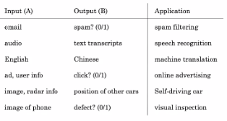
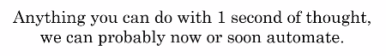
Supervised learning
Notes:
Previously, you saw this list of AI applications from spam filtering to speech recognition, to machine translation, and so on. One imperfect rule of thumb you can use to decide what supervised learning may or may not be able to do is that, pretty much anything you could do with a second of thought, we can probably now or soon automate using supervised learning, using this input-output mapping.
So for example, in order to determine the position of other cars, that's something that you can do with less than a second.
In order to tell if a phone is scratched, you can look at it and you can tell in less than a second.
In order to understand or at least transcribe what was said, it doesn't take that many seconds of thought.
While this is an imperfect rule of thumb, it maybe gives you a way to quickly think of some examples of tasks that AI systems can do.
Whereas in contrast, something that AI today cannot do would be: to analyze a market and write a 50 page report, a human cannot write a 50 page mark of analysis report in a second, and it's very difficult, at least I don't know. I don't think any team in the world today knows how to get an AI system to do market research and run an extended market report either. I've found out one of the best ways to hone intuition is to look at concrete examples

Slide 43
What machine learning can and cannot do
So for example, in order to determine the position of other cars, that's something that you can do with less than a second.
In order to tell if a phone is scratched, you can look at it and you can tell in less than a second.
In order to understand or at least transcribe what was said, it doesn't take that many seconds of thought.
While this is an imperfect rule of thumb, it maybe gives you a way to quickly think of some examples of tasks that AI systems can do.
Notes:
Whereas in contrast, something that AI today cannot do would be: to analyze a market and write a 50 page report, a human cannot write a 50 page mark of analysis report in a second, and it's very difficult, at least I don't know. I don't think any team in the world today knows how to get an AI system to do market research and run an extended market report either. I've found out one of the best ways to hone intuition is to look at concrete examples

Slide 44
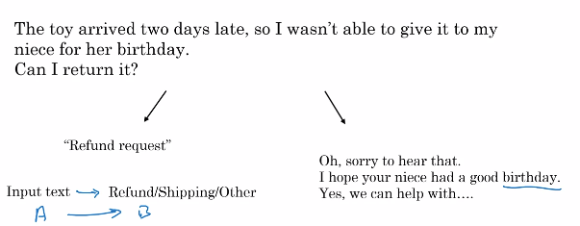
What machine learning can and cannot do
Notes:
So, let's take a look at a specific example, relating to customer support automation. Let's see a random website that sells things, so an e-commerce company, and you have a customer support division that gets an email like this, "The toy arrived two days late, so I wasn't able to give it to my niece for her birthday. Can I return it?" If what you want is an AI system that looks at this and decides this is a refund request, so let me route it to my refund department, then I will say, you have a good chance of building an AI system to do that. The AI system would take as input, the customer text, what the customer emails you, and it would output, is this a refund requests or is this a shipping problem, or is it the other request, in order to route this email to the most appropriate parts of your customer support center So, the input A is the text and the output B is one of these three outcomes, is it a refund or a shipping problem, or shipping query, or is it a different requests. So, this is something that AI today can do. Here's something that AI today cannot do which is if you want the AI to input an email and automatically generate, it responds like, "Oh, sorry to hear that. I hope you're niece had a good birthday. Yes, we can help with, and so on." So, for an AI to output a complicated piece of text like this today is very difficult by today's standards of AI and in fact to even empathize about the birthday of your niece, that is very difficult to do for every single possible type of email you might receive. Now, what would happen if you were to use a machine learning tool like a deep learning algorithm to try to do this anyway

Slide 45
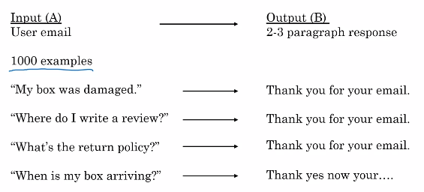
What Happens If You Try?
Notes:
So, let's say you tried to get an AI system to input the user's email, and output a two to the three paragraph, empathetic and appropriate response. Let's say that you have a modest-sized dataset like a 1,000 examples of user emails and appropriate responses. It turns out if you run an AI system on this type of data, on a small dataset like 1,000 examples, this may be the performance you get, which is if a user emails, "My box was damaged," they'll say, "Thank you for your email," and it says, "Where do I write a review?", "Thank you email." "What's the return policy?", "Thank you for your email." But the problem with building this type of AI is that with just a 1,000 examples, there's just not enough data for an AI system to learn how to write to the three paragraph, appropriate and empathetic responses. So, you may end up just generating the same very simple response like, "Thank you for your email," no matter what the customer is sending you. Another thing that could go wrong, another way for an AI system to fail is if it generates gibberish such as: "When is my box arriving," and it says, "Thank, yes, now your," gibberish. This is a hard enough problem that even with 10,000 or a 100,000 email examples, I don't know if that would be enough data for an AI system to do this well. The rules for what AI can and cannot do are not hardened first and I usually end up having to ask engineering teams to sometimes spend a few weeks doing deep technical diligence to decide for myself if a project is feasible.

Slide 46
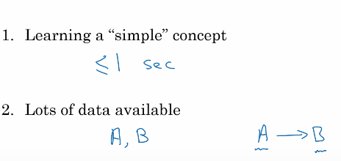
What makes an ML Problem Easier
Notes:
But to hone your intuitions to help you quickly filter feasible or not feasible projects, here are a couple of other rules of thumb about what makes a machine learning problem easier or more likely to be feasible. One, learning a simple concept is more likely to be feasible. Well, what does a simple concept mean? There's no formal definition of that but it is something that takes you less than a second of mental thought or a very small number of seconds of mental thought to come up with a conclusion then that would lean to whether it being a simple concept. So, you're looking outside the window of a self-driving car to spot the other cars that would be a relatively simple concept. Whereas how to write an empathetic response, so a complicated user complaints, that would be less of a simple concept. Second, a machine learning problem is more likely to be feasible if you have lots of data available. Here, our data means both the input A and the output B, that you want the AI system to have in your A to B, input to output mapping. So for example, in the customer support application, the input A would be examples of emails from customers and B could be labeling each of these customer emails as to whether it's a refund requests or a shipping query, or some other problem, one of three outcomes. Then if you have thousands of emails with both A and B, then the odds of you building a machine learning system to do that would be pretty good.
AI is the new electricity and it's transforming every industry, but it's also not magic and it can't do everything under the sun.
I hope that this started to help you hone your intuitions about what it can and cannot do, and increase the odds of your selecting feasible and valuable projects for maybe your teams to try working on.
In order to help you continue developing your intuition, I would like to show you more examples of what AI can and cannot do.

Slide 47
What machine learning can and cannot do
AI is the new electricity and it's transforming every industry, but it's also not magic and it can't do everything under the sun.
I hope that this started to help you hone your intuitions about what it can and cannot do, and increase the odds of your selecting feasible and valuable projects for maybe your teams to try working on.
In order to help you continue developing your intuition, I would like to show you more examples of what AI can and cannot do.
Notes:
Let's go into the next slide.

Slide 48
What is AI? More examples of what machine learning can and cannot do

Slide 49
More examples of what machine learning can and cannot do
One of the challenges of becoming good at recognizing what AI can and cannot do is that it does take seeing a few examples of concrete successes and failures of AI.
If you work on an average of say, one new AI project a year, then to see three examples would take you three years of work experience and that's just a long time.
Notes:
What I hope to do, both in the previous slides and in next slides is to quickly show you a few examples of AI successes and failures, or what it can and cannot do so that in a much shorter time, you can see multiple concrete examples to help hone your intuition and select valuable projects. So, let's take a look at a few more examples.

Slide 50
More examples of what machine learning can and cannot do
Let's say you're building a self-driving car, here's something that AI can do pretty well, which is to take a picture of what's in front of your car and maybe just using a camera, maybe using other senses as well such as radar or lidar.
Then to figure out, what is the position, or where are the other cars.
So, this would be an AI where the input A, is a picture of what's in front of your car, or maybe both a picture as well as radar and other sensor reading

Slide 51
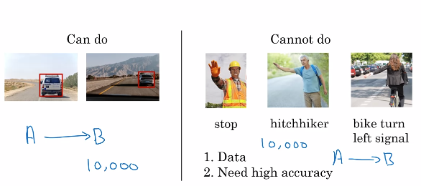
Self Driving Car
Notes:
Let's say you're building a self-driving car, here's something that AI can do pretty well, which is to take a picture of what's in front of your car and maybe just using a camera, maybe using other senses as well such as radar or lidar.
Then to figure out, what is the position, or where are the other cars.
So, this would be an AI where the input A, is a picture of what's in front of your car, or maybe both a picture as well as radar and other sensor reading
The output B is, where are the other cars? Today, the self-driving car industry has figured out how to collect enough data and has pretty good algorithms for doing this reasonably well. So, that's what the AI today can do.
Here's an example of something that today's AI cannot do, or at least would be very difficult using today's AI, which is to input a picture and output the intention of whatever the human is trying to gesture at your car. So, here's a construction worker holding out a hand to ask your car to stop. Here's a hitchhiker trying to wave a car over. Here is a bicyclist raising the left-hand to indicate that they want to turn left. So, if you were to try to build a system to learn the A to B mapping, where the input A is a short lesson of our human gesturing at your car, and the output B is, what's the intention or what does this person want, that today is very difficult to do. Part of the problem is that the number of ways people gesture at you is very, very large. Imagine all the hand gestures someone could conceivably use asking you to slow down or go, or stop. The number of ways that people could gesture at you is just very, very large. So, it's difficult to collect enough data from enough thousands or tens of thousands of different people gesturing at you, and all of these different ways to capture the richness of human gestures. So, learning from a video to what this person wants, it's actually a somewhat complicated concept. In fact, even people have a hard time figuring out sometimes what someone waving at your car wants. Then second, because this is a safety critical application, you would want an AI that is extremely accurate in terms of figuring out, does a construction worker want you to stop, or does he or she wants you to go? And that makes it harder for an AI system as well. So, today if you collect just say, 10,000 pictures of other cars, many teams would build an AI system that at least has a basic capability at detecting other cars. In contrast, even if you collect pictures or videos of 10,000 people, it's quite hard to track down 10,000 people waving at your car. Even with that data set, I think it's quite hard today to build an AI system to recognize humans intentions from their gestures at the very high level of accuracy needed in order to drive safely around these people. So, that's why today, many self-driving car teams have some components for detecting other cars, and they do rely on that technology to drive safely. But very few self-driving car teams are trying to count on the AI system to recognize a huge diversity of human gestures and counting just on that to drive safely around people

Slide 52
More examples of what machine learning can and cannot do
Say you want to build an AI system to look at X-ray images and diagnose pneumonia. So, all of these are chest X-rays.
So, the input A could be the X-ray image and the output B can be the diagnosis.
Does this patient have pneumonia or not?
So, that's something that AI can do.
Something that AI cannot do would be to diagnose pneumonia from 10 images of a medical textbook chapter explaining pneumonia.
Notes:
Let's look at one more example.

Slide 53
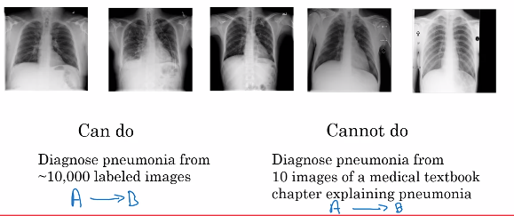
X Ray Diagnosis
Notes:
Say you want to build an AI system to look at X-ray images and diagnose pneumonia. So, all of these are chest X-rays.
So, the input A could be the X-ray image and the output B can be the diagnosis.
Does this patient have pneumonia or not?
So, that's something that AI can do.
Something that AI cannot do would be to diagnose pneumonia from 10 images of a medical textbook chapter explaining pneumonia.
A human can look at a small set of images, maybe just a few dozen images, and reads a few paragraphs from medical textbook and start to get a sense. But actually don't know, given a medical textbook, what is A and what is B? Or how to really pose this as an AI problems like know how to write a piece of software to solve, if all you have is just 10 images and a few paragraphs of text that explain what pneumonia in a chest X-ray looks like. Whereas a young medical doctor might learn quite well reading a medical textbook at just looking at maybe dozens of images. In contrast, an AI system isn't really able to do that today.

Slide 54
More examples of what machine learning can and cannot do
Machine learning tends to work well when you're trying to learn a simple concept, such as something that you could do with less than a second of mental thought, and when there's lots of data available.
Machine learning tends to work poorly when you're trying to learn a complex concept from small amounts of data
Notes:
To summarize, here are some of the strengths and weaknesses of machine learning.

Slide 55
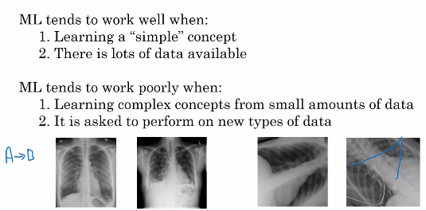
Strengths and Weaknesses Of ML
Notes:
Machine learning tends to work well when you're trying to learn a simple concept, such as something that you could do with less than a second of mental thought, and when there's lots of data available.
Machine learning tends to work poorly when you're trying to learn a complex concept from small amounts of data
A second underappreciated weakness of AI is that it tends to do poorly when it's asked to perform on new types of data that's different than the data it has seen in your data set. Let me explain with an example. Say you built a supervised learning system that uses A to B to learn to diagnose pneumonia from images like these. These are well pretty high quality chest X-ray images. But now, let's say you take this AI system and apply it at a different hospital or different medical center, where maybe the X-ray technician somehow strangely had the patients always lie at an angle or sometimes there are these defects. Not sure if you can see the lost structures in the image. These low other objects lying on top of the patients. If the AI system has learned from data like that on your left, maybe taken from a high-quality medical center, and you take this AI system and apply it to a different medical center that generates images like those on the right, then it's performance will be quite poor as well. A good AI team would be able to ameliorate, or to reduce some of these problems, but doing this is not that easy. This is one of the things that AI is actually much weaker than humans. If a human has learned from images on the left, they're much more likely to be able to adapt to images like those on the right as they figure out that the patient is just lying on an angle. But then AI system can be much less robust than human doctors in generalizing or figuring out what to do with new types of data like these.

Slide 56
More examples of what machine learning can and cannot do
I hope these examples are helping you hone your intuitions about what AI can and cannot do. In case the boundary between what it can or cannot do still seems fuzzy to you, don't worry.
It is completely normal, completely okay. In fact even today, I still can't look at a project and immediately tell is something that's feasible or not.
I often still need weeks or small numbers of weeks of technical diligence before forming strong conviction about whether something is feasible or not.
Notes:
But I hope that these examples can at least help you start imagining some things in your company that might be feasible and might be worth exploring more. The next slides after this are optional and are a non-technical description of what are neural networks and what is deep learning. Please feel free to watch those. Then next lesson, we'll go much more deeply into the process of what building an AI project would look like. I look forward to seeing you next lesson.

Slide 57
What is AI? Non-technical explanation of deep learning (Part 1)

Slide 58
Non-technical explanation of deep learning (Part 1, optional)
The terms deep learning and neural network are used almost interchangeably in AI.
And even though they're great for machine learning, there's also been a bit of hype and bit of mystique about them.
This will demystify deep learning, so that you have a sense of what deep learning and neural networks really are.

Slide 59
Non-technical explanation of deep learning (Part 1, optional)
Let's use an example from demand prediction. Let's say you run a website that sells t-shirts.
And you want to know, based on how you price the t-shirts, how many units you expect to sell, how many t-shirts you expect to sell.
You might then create a dataset like this, where the higher the price of the t-shirt, the lower the demand.
So you might fit a straight line to this data, showing that as the price goes up, the demand goes down.

Slide 60
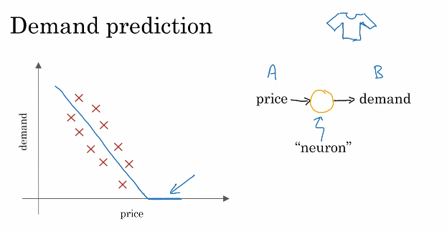
Non-technical explanation of deep learning (Part 1, optional)
Notes:
The terms deep learning and neural network are used almost interchangeably in AI.
And even though they're great for machine learning, there's also been a bit of hype and bit of mystique about them.
This will demystify deep learning, so that you have a sense of what deep learning and neural networks really are.
Let's use an example from demand prediction. Let's say you run a website that sells t-shirts.
And you want to know, based on how you price the t-shirts, how many units you expect to sell, how many t-shirts you expect to sell.
You might then create a dataset like this, where the higher the price of the t-shirt, the lower the demand.
So you might fit a straight line to this data, showing that as the price goes up, the demand goes down.
Now demand can never go below zero, so maybe you say that the demand will flatten out at zero, and beyond a certain point you expect pretty much no one to buy any t-shirts. It turns out this blue line is maybe the simplest possible neural network. You have as input the price, A, and you want it to output the estimated demand, B. So the way you would draw this as a neural network is that the price will be input to this little round thing there, and this little round thing outputs the estimated demand. In the terminology of AI, this little round thing here is called a neuron, or sometimes it's called an artificial neuron, and all it does is compute this blue curve that I've drawn here on the left. This is maybe the simplest possible neural network with a single artificial neuron, that just inputs the price and outputs the estimated demand. If you think of this orange circle, this artificial neuron as a little Lego brick, all that a neural network is, if you take a lot of these Lego bricks and stack them on top of each other until you get a big power, a big network of these neurons. Let's look at a more complex example.

Slide 61
Demand Prediction
Suppose that instead of knowing only the price of the product, you also have the shipping costs that the customers will have to pay to get the product.
May be you spend more or less on marketing in a given week, and you can also make the product out of high quality material.
Notes:
May be you spend more or less on marketing in a given week, and you can also make the product out of a thick, heavy, expensive cotton or a much cheaper, more lightweight material.

Slide 62
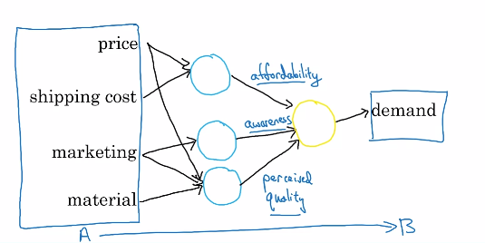
Demand Prediction
Notes:
These are some of the factors that you think will affect the demand for your t-shirts. Let's see what a more complex neural network might look like. You know that your consumers care a lot about affordability. So let's say you have one neuron, and let me draw this one in blue, whose job it is to estimate the affordability of the t-shirts. And so affordability is mainly a function of the price of the shirts and of the shipping cost. A second thing though affecting demand for your t-shirts is awareness How much are consumers aware that you're selling this t-shirt? So the main thing that affects awareness, is going to be your marketing. So let me draw here a second artificial neuron that inputs your marketing budget, how much you spend on marketing, and outputs how aware are consumers of your t-shirt. Finally, the perceived quality of your product will also affect demand, and perceived quality would be affected by marketing. The marketing tries to convince people this is a high quality t-shirt, and sometimes the price of something also affects perceived quality. So I'm going to draw here a third artificial neuron that inputs price, marketing and material, and tries to estimate the perceived quality of your t-shirts. Finally, now that the earlier neurons, these three blue neurons, have figured out how affordable, how much consumer awareness and what's the perceived quality, you can then have one more neuron over here that takes as input these three factors and outputs the estimated demand. So this is a neural network, and its job is to learn to map from these four inputs, that's the input A, to the output B, to demand.

Slide 63
Non-technical explanation of deep learning (Part 1, optional)
So It learns this input output or A to B mapping.
This is a fairly small neural network with just four artificial neurons.
In practice, neural networks used today are much larger, with easily thousands, tens of thousands or even much larger than that numbers of neurons.
Notes:
Now, there's just one final detail of this description that I want to clean up, which is that in the way I've described the neural network, it was as if you had to figure out that the key factors are affordability, awareness and perceived quality. One of the wonderful things about using neural networks is that to train a neural network, in other words, to build a machine learning system using neural network, all you have to do is give it the input A and the output B. And it figures out all of the things in the middle by itself

Slide 64
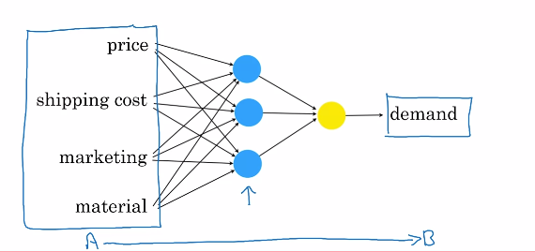
Demand Prediction
Notes:
So to build a neural network, what you would do is feed it lots of data, or the input A, and have a neural network that just looks like this, with a few blue neurons feeding to a yellow open neuron. And then you have to give it data with the demand B as well. And it's the software's job to figure out what these blue neurons should be computing, so that it can completely automatically learn the most accurate possible function mapping from the input A to the output B. And it turns out that if you give this enough data and train a neural network that is big enough, this can do an incredible good job mapping from inputs A to outputs B.

Slide 65
Non-technical explanation of deep learning (Part 1, optional)
So that's a neural network, is a group of artificial neurons each of which computes a relatively simple function.
But when you stack enough of them together like Lego bricks, they can compute incredibly complicated functions that give you very accurate mappings from the input A to the output B.
Now, in this you saw an example of neural networks applied to demand prediction.
Notes:
Let's go on to the next slides to see a more complex example of neural networks applied to face recognition.

Slide 66
What is AI? Non-technical explanation of deep learning (Part 2, optional)

Slide 67
Non-technical explanation of deep learning (Part 2, optional)
In the last, you saw how a neural network can be applied to demand prediction, but how can the new network look at the picture and figure out what's in the picture?
Or listen to an audio clip and understand what is said in an audio clip?
Let's take a look at a more complex example of applying a neural network to face recognition.

Slide 68
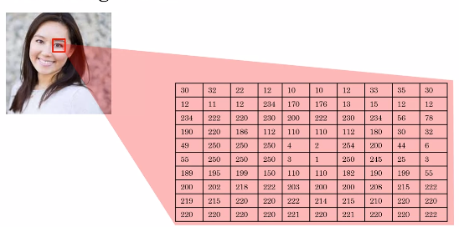
Face Recognition
Notes:
Say you want to build a system to recognize people from pictures, how can a piece of software look at this picture and figure out the identity of the person in it? Let's zoom in to a little square like that to better understand how a computer sees pictures. Where you and I see a human eye, a computer instead sees that, and sees this grid of pixel brightness values that tells it, for each of the pixels in the image, how bright is that pixel. If it were a black and white or grayscale image, then each pixel would correspond to a single number telling you how bright is that pixel. If it's a color image, then each pixel will actually have three numbers, corresponding to how bright are the red, green, and blue elements of that pixel. So, the neural networks job is to take as input a lot of numbers like these and tell you the name of the person in the picture.

Slide 69
Non-technical explanation of deep learning (Part 2, optional)
You saw how a neural network can take as input four numbers corresponding to the price, shipping costs, amounts of marketing, and cloth material of a T-shirt and output demand.
In this example, the neural network just has to input a lot more numbers corresponding to all of the pixel brightness values of this picture.
If the resolution of this picture is 1000 pixels by 1000 pixels, then that's a million pixels.

Slide 70
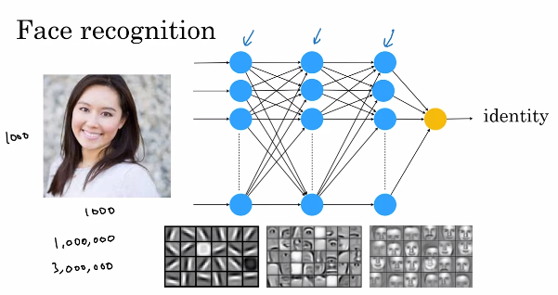
Non-technical explanation of deep learning (Part 2, optional)
Notes:
You saw how a neural network can take as input four numbers corresponding to the price, shipping costs, amounts of marketing, and cloth material of a T-shirt and output demand.
In this example, the neural network just has to input a lot more numbers corresponding to all of the pixel brightness values of this picture.
If the resolution of this picture is 1000 pixels by 1000 pixels, then that's a million pixels.
So, if it were a black and white or grayscale image, this neural network was take as input a million numbers corresponding to the brightness of all one million pixels in this image or if was a color image it would take as input three million numbers corresponding to the red, green, and blue values of each of these one million pixels in this image. Similar to before, you will have many of these artificial neurons computing various values, and it's not your job to figure out what these neuron should compute. The neural network will figured out by itself. Typically, when you give it an image, the neurons in the earlier parts of the neural network will learn to detect edges in pictures and then lobe and later learn to detect parts of objects. So, they learn to detect eyes and noses and the shape of cheeks and the shape of mouths, and then the later neurons, further to the right, will learn to detect different shapes of faces and it will finally, put all this together to output the identity of the person in the image Again, part of the magic of neural networks is that you don't really need to worry about what it is doing in the middle. All you need to do is give it a lot of data of pictures like this, A, as well as the correct identity B and the learning algorithm will figure out by itself what each of these neurons in the middle should be computing

Slide 71
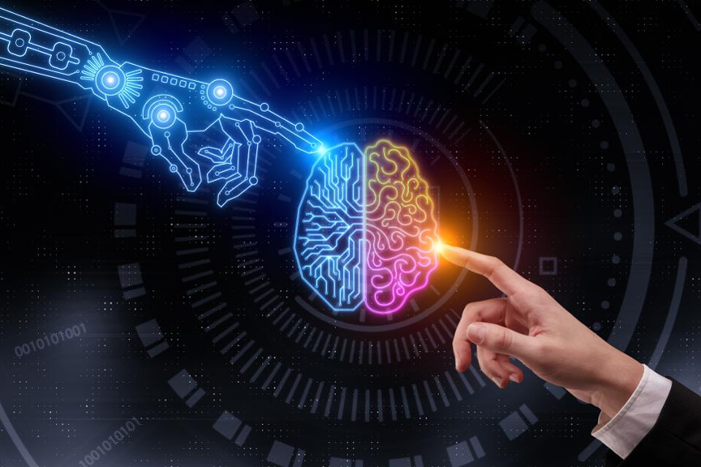
Non-technical explanation of deep learning (Part 2, optional)
Congratulations on finishing this. You now know how machine learning and data science work.

Slide 72
Building AI Projects? Introduction

Slide 73
Introduction
Welcome back. Previously, you learned about the basics of AI and machine learning technology.
But how do you use this technology in a project, either if you want to do a project in your proverbial garage or if you want to do your project in a bigger company, or maybe even have something that builds up to align with your corporate strategy?

Slide 74
Introduction
Now you will learn what the workflow of an AI project. Different projects have different steps.
First, you figure out the guest list, and you find a venue, then you order the birthday cake, and send invites, and so on. So, too does an AI project have a sequence of predictable steps.

Slide 75
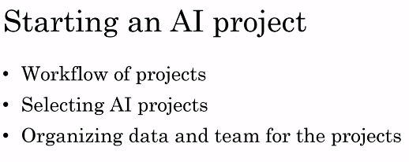
Introduction
Notes:
So, through this, you learn what is the workflow of an AI project, you learn what it feels like to be working on an AI project. Second, how do you select an AI project? Seems there are a lot of things you could do. The second thing you learned this week is a framework for brainstorming and selecting potentially promising projects to work on, either by yourself or with a few friends, or as part of a bigger company effort.
Finally, you also learn how to organize the data as well as the team, which again could be just you are a few friends or much bigger corporate team.
We learn how to organize the data and team for executing on an AI project.
By the end of this, you know what it feels like and how to build your own AI project, and maybe you'll be able to start exploring with some of your friends promising ideas to try

Slide 76
Introduction
Finally, you also learn how to organize the data as well as the team, which again could be just you are a few friends or much bigger corporate team.
We learn how to organize the data and team for executing on an AI project.
By the end of this, you know what it feels like and how to build your own AI project, and maybe you'll be able to start exploring with some of your friends promising ideas to try

Slide 77
Building AI Projects? Workflow of a machine learning project

Slide 78
Workflow of a machine learning project
Machine learning algorithms can learn input to output or A to B mappings.
So, how do you build a machine learning project?
In this, you'll learn what is the workflow of machine learning projects. Let's take a look.

Slide 79
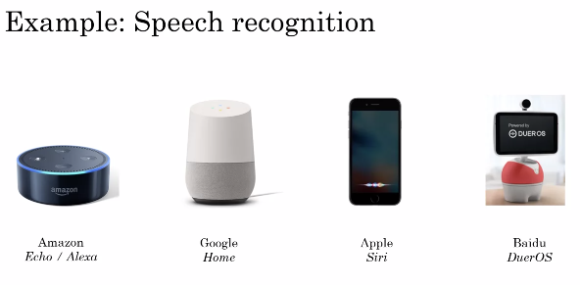
Workflow of a machine learning project
Notes:
I'm going to use speech recognition. So, some of you may have an Amazon Echo or Google Home or Apple Siri device or a Baidu DuerOS device in your homes. Today, I actually have a Amazon Echo in my kitchen. So, every time I'm boiling an egg I will say, "Alexa, set timer for three minutes," and then it lets me know when the three minutes are up and my eggs are ready. So, how do you build a speech recognition system that can recognize when you say, "Alexa," or "Hey, Google," or "Hey, Siri," or "Hello, Baidu"?

Slide 80
Workflow of a machine learning project
Let's go through the key steps of a machine learning project. Just for simplicity, I'm going to use Amazon Echo or detecting the Alexa keywords as this running example.
If you want to build an AI system or build a machine learning system to figure out when a user has said the word Alexa, the first step is to collect data.

Slide 81
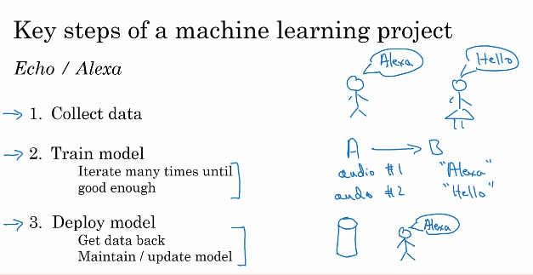
Workflow of a machine learning project
Notes:
So, that means, you would go around and get some people to say the word "Alexa" for you and you record the audio of that. You'll also get a bunch of people to say other words like "Hello," or say lots of other words and record the audio of that as well. Having collected a lot of audio data, a lot of these audio clips of people saying either "Alexa" or saying other things, step two is to then train the model. This means you will use a machine learning algorithm to learn an input to output or A to B mapping, where the input A would be an audio clip. In the case of the first audio clip above, hopefully, it will tell you that the user said "Alexa," and in the case of audio clip two, shown on the right, hopefully, the system will learn to recognize that the user has said "Hello."Whenever an AI team starts to train the model, meaning to learn the A to B or input-output mapping, what happens, pretty much every time, is the first attempt doesn't work well. So invariably, the team will need to try many times or in AI, we call this iterate many times. You have to iterate many times until, hopefully, the model looks like is good enough.The third step is to then actually deploy the model. What that means is you put this AI software into an actual smart speaker and ship it to either a small group of test users or to a large group of users. What happens in a lot of AI products is that when you ship it, you see that it starts getting new data and it may not work as well as you had initially hoped. So, for example, I am from the UK. So, I'm going to pick on the British. But let's say you had trained your speech recognition system on American-accented speakers and you then ship this smart speaker to the UK and you start having British-accented people say "Alexa." They may find that it doesn't recognize the speech as well as you had hoped. When that happens, hopefully, you can get data back of cases such as maybe British-accented speakers was not working as well as you're hoping, and then use this data to maintain and to update the model. So, to summarize, the key steps of a machine learning project are to collect data, to train the model, the A to B mapping, and then to deploy the model. Throughout these steps, there is often a lot of iteration, meaning fine-tuning or adapting the model to work better or getting data back even after you've shipped it to, hopefully, make the product better, which may or may not be possible depending on whether you're able to get data back. Let's look at these three steps and see how they apply on a different project on building a key component of a self-driving car. So, remember the key steps, you collect data, you train model, deploy model, since we'll revisit these steps on the next slide

Slide 82
Workflow of a machine learning project
Let's say you're building a self-driving car. One of the key components of a self-driving car is a machine learning algorithm that takes as input, say a picture, of what's in front of your car and tells you where are the other cars.
So, what's the first step of building this machine learning system?
Hopefully, you remember from the last slide that the first step was to collect data.
Notes:
So, if your goal is to have a machine learning algorithm that can take as input an image and output the position of other cars, the data you would need to collect would be both images as well as position of other cars that you want the AI system to output. So, what's the first step of building this machine learning system? Hopefully, you remember from the last slide that the first step was to collect data. So, if your goal is to have a machine learning algorithm that can take as input an image and output the position of other cars, the data you would need to collect would be both images as well as position of other cars that you want the AI system to output.

Slide 83
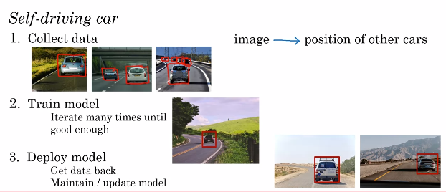
Keysteps of a machine learning project
Notes:
So, let's say you start off with a few pictures like this. These are the inputs A to the machine learning algorithm. You need to also tell it what is the output B you would want. So, for each of these pictures, you would draw a rectangle around the cars in the picture that you wanted to detect. On this slide, I'm hand drawing these rectangles, but in practice, you will use some software that lets you draw perfect rectangles rather than these hand-drawn ones. Then, having created this dataset, what was the second step? Hope you remember that the second step was to train the model. Now, invariably, when your AI engineers start training a model, they'll find, initially, that it doesn't work that well. For example, given this picture, maybe the software, the first few tries, thinks that that is a car. It's only by iterating many times that you, hopefully, get a better result when figuring out that that is where the car actually is. Finally, what was the third step? It was to deploy the model. Of course, in the self-driving world, it's important to treat safety as number one, and deploy model or to test the model only in ways that can preserve safety. But when you put the software in cars on the road, you may find that there are new types of vehicles, say golf carts, that the software isn't detecting very well. So, you get data back, say, pictures of these golf carts, using new data to maintain and update the model so that, hopefully, you can have your AI software continually get better and better to the point where you end up with a software that can do a pretty good job detecting other cars from pictures like these

Slide 84
Workflow of a machine learning project
In this , you learned what are the key steps of a machine learning project, which are to collect data, to train the model, and then to deploy the model.
Next, let's take a look at what are the key steps or what is a workflow of a data science project. Let's go on to the next slides

Slide 85
Building AI Projects? Workflow of a data science project

Slide 86
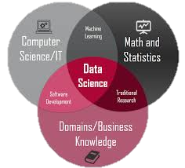
Workflow of a data science project
Unlike a machine learning project, the output of a data science project is often a set of actionable insights, a set of insights that may cause you to do things differently.
So, data science projects have a different workflow than machine learning projects.
Let's take a look at one of the steps of a data science project.

Slide 87
Workflow of a data science project
Say you run a e-commerce or a online shopping website that sells coffee mugs and so for a user to buy a coffee mug from you, there's a sequence of steps they'll usually follow.
First, they'll visit your website and take a look at the different coffee mugs on offer, then eventually, they have to get to a product page, and then they'll have to put it into their shopping cart, and go to the shopping cart page, and then they'll finally have to check out.
Notes:
As our running example, let's say you want to optimize a sales funnel.

Slide 88
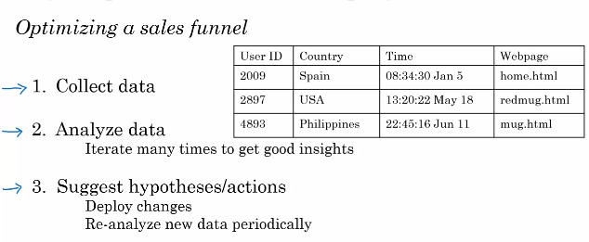
Key Steps of a data science project
Notes:
Say you run a e-commerce or a online shopping website that sells coffee mugs and so for a user to buy a coffee mug from you, there's a sequence of steps they'll usually follow.
First, they'll visit your website and take a look at the different coffee mugs on offer, then eventually, they have to get to a product page, and then they'll have to put it into their shopping cart, and go to the shopping cart page, and then they'll finally have to check out.
As our running example, let's say you want to optimize a sales funnel.
So, if you want to optimize the sales funnel to make sure that as many people as possible get through all of these steps, how can you use data science to help with this problem? Let's look at the key steps of a data science project. The first step is to collect data. So, on a website like the one we saw, you may have a data set that stores when different users go to different web pages. In this simple example, I'm assuming that you can figure out the country that the users are coming from, for example, by looking at their computers' address, called an IP address, and figuring out what is the country from which they're originating. But in practice, you can usually get quite a bit more data about users than just what country they're from. The second step is to then analyze the data. Your data science team may have a lot of ideas about what is affecting the performance of your sales funnel. For example, they may think that overseas customers are scared off by the international shipping costs which is why a lot of people go to the checkout page but don't actually check out. If that's true then you might think about whether to put part of shipping costs into the actual product costs or your data science team may think there are blips in the data whenever there's a holiday. Maybe more people will shop around the holidays because they're buying gifts or maybe fewer people will shop around the holidays because they're staying home rather than sometimes shopping from their work computers. In some countries, there may be time-of-day blips where in countries that observe a siesta, so a time of rest like an afternoon rest, there may be fewer shoppers online and so your sales may go down. They may then suggest that you should spend fewer advertising dollars during the period of siesta because fewer people will go online to buy at that time. So, a good data science team may have many ideas and so they try many ideas or will say iterate many times to get good insights. Finally, the data science team will distill these insights down to a smaller number of hypotheses about ideas of what could be going well and what could be going poorly as well as a smaller number of suggested actions such as incorporating shipping costs into the product costs rather than having it as a separate line item. When you take some of these suggested actions and deploy these changes to your website, you then start to get new data back as users behave differently now that you advertise differently at the time of siesta or have a different check out policy. Then your data science team can continue to collect data and we analyze the new data periodically to see if they can come up with even better hypotheses or even better actions over time. So the key steps of a data science project are to collect the data, to analyze the data, and then to suggest hypotheses and actions, and then to continue to get the data back and reanalyze the data periodically. Let's take this framework and apply it to a new problem, to optimizing a manufacturing line.

Slide 89
Workflow of a data science project
Let's say you run a factory that's manufacturing thousands of coffee mugs a month for sale and you want to optimize the manufacturing lines So, these are the key steps in manufacturing coffee mugs.
Step one is to mix the clay, so make sure the appropriate amount of water is added. Step two is take this clay and to shape the mugs.
Then you have to add the glaze, so add the coloring, a protective cover. Then you have to heat this mug and we call that firing the kiln.
Notes:
So we'll take these three steps and use them on the next slide as well.

Slide 90
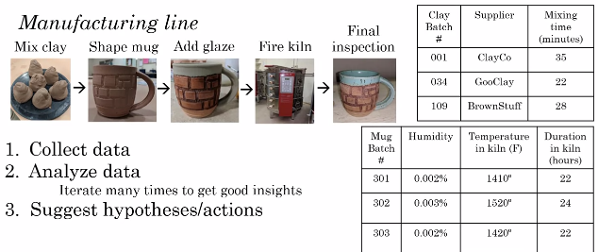
Key Steps of a data science project
Notes:
Let's say you run a factory that's manufacturing thousands of coffee mugs a month for sale and you want to optimize the manufacturing lines So, these are the key steps in manufacturing coffee mugs.
Step one is to mix the clay, so make sure the appropriate amount of water is added. Step two is take this clay and to shape the mugs.
Then you have to add the glaze, so add the coloring, a protective cover. Then you have to heat this mug and we call that firing the kiln.
Finally, you would inspect the mug to make sure there aren't dents in the mug and it isn't cracked before you ship it to customers. So, a common problem in manufacturing is to optimize the yield of this manufacturing line to make sure that as few damaged coffee mugs get produced as possible because those are coffee mugs you have to throw away, resulting in time and material waste. What's the first step of a data science project? I hope you remember from the last slide that the first step is to collect data. So for example, you may save data about the different batches of clay that you've mixed, such as who supplied the clay and how long did you mix it, or maybe how much moisture was in the clay, how much water did you add. You might also collect data about the different batches of mugs you made. So how much humidity was in that batch? What was the temperature in the kiln and how long did you fire it in the kiln? Given all this data you would then ask the data science team to analyze the data and they would, as before, iterate many times to get good insights. So, they may find that, for example, that whenever the humidity is too low and the kiln temperature is too hot that there are cracks in the mug or they may find out that because it's warmer in the afternoon that you need to adjust the humidity and temperature depending on the time of day. Based on the insights from your data science team you get suggestions for hypotheses and actions on how to change the operations and manufacturing line in order to improve the productivity of the line. When you deploy the changes, you then get new data back that you can reanalyze periodically so they can keep on optimizing the performance of your manufacturing line.

Slide 91
Workflow of a data science project
To summarize, the key steps of a data science project are to collect the data, to analyze the data, and then to suggest hypotheses and actions.
In this and the last slide you saw some examples of machine learning projects and data science projects.
It turns out that machine learning and data science are affecting almost every single job function.
Notes:
What I want to do in the next is show you how these ideas are affecting many job functions, including perhaps yours and certainly that of many of your colleagues. Let's go on to the next slide.

Slide 92
Building AI Projects? Every job function needs to learn how to use data

Slide 93
Every job function needs to learn how to use data
Data is transforming many different job functions, whether you work in recruiting or sales or marketing or manufacturing or agriculture, data is probably transforming your job function. What's happened in the last few decades is the digitization of our society.
So, rather than handing out papers surveys like these, surveys are more likely to be done in digital format or doctors still write some handwritten notes but doctors handwritten note is increasingly likely to be a digital record a digital record and so to this in just about every single job function.
Notes:
This availability of data means that there's a good chance that your job function could be helped with tools like data science or machine learning. Let's take a look. In this, I want to run through many different job functions and discuss how data science and machine learning can or will impact these different types of jobs.

Slide 94
Every job function needs to learn how to use data
Machine learning can help you prioritize these leads.
So, you might want to prioritize calling up the CEO of a large company rather than the intern at a much smaller company and this type of automated leads sorting is making salespeople more efficient.
Let say you're manufacturing line manager. You've already seen how data science can help you optimize a manufacturing line.
Notes:
Let's start with sales. You've already seen in the last how data science can be used to optimize a sales funnel. How about machine learning? If you're a salesperson you may have a set of leads about different people that you could reach out to convince them to buy something from your company.

Slide 95
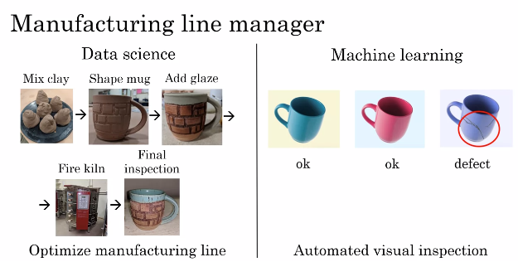
Every job function needs to learn how to use data
Notes:
How about machine learning? One of the steps of this manufacturing process is the final inspection. In fact today, in many factories there can be hundreds or thousands of people using the human eye to check over objects, maybe coffee mugs, maybe other things to see if they're scratches or dents and that's called inspection. So, machine learning can take this input, a dataset like this, and learn to automatically figure out if a coffee mug is defective or not. By automatically finding scratches or dents, it can reduce labor costs and also improve quality in your factory. This type of automated visual inspection is one of the technologies that I think will have a big impact on manufacturing. This is something I've been working on myself as well.

Slide 96
Every job function needs to learn how to use data
How about recruiting?
When recruiting someone to join your company, there may be a pretty predictable sequence of steps where your recruiter or someone else would send an email to a candidate and then you'd have a phone call with them, bring them on-site for an interview and then extend an offer and maybe close the offer.
Similar to how data science can be used to optimize a sales funnel, recruiting can also use data science to optimize a recruiting funnel and in fact many recruiting organizations are doing so today
Notes:
Let's see more examples.

Slide 97
Every job function needs to learn how to use data
For example, if you find that hardly anyone is making it from phone screen step to the on-site interviews step then you may conclude that maybe too many people are getting into the phone screen stage or maybe the people doing the phone screen are just being too tough and you should let more people get to the onsite interview stage.
This type of data science is already having an impact on recruiting. What about machine learning projects? What about machine learning projects? Well, one of the steps of recruiting is to screen a lot of resumes to decide who to reach out to you.
Notes:
So, you may have to look at one resume and say, "Yes, let's email them", look at a different one to say, "No, let us not move ahead with this candidate." Machine learning is starting to make its way into automated resume screening.

Slide 98
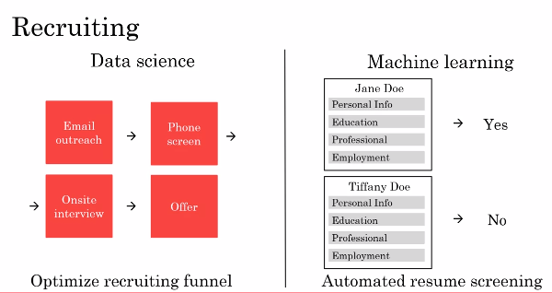
Every job function needs to learn how to use data
Notes:
Does raise important ethical questions such as making sure that your AI software does not exhibit undesirable forms of bias and treats people fairly, but machine learning is starting to make inroads into this and I hope can do so while making sure that the systems are ethical and fair. In the final lesson of this AI For Everyone course, you'll also learn more about the issues of fairness and ethics in AI.

Slide 99
Every job function needs to learn how to use data
What if you work in marketing? One of the common ways to optimize the performance in website is called AB testing, in which you launch two versions of website.
Here version A has a red button, version B has a green button and you measure which websites causes people to click through more.
So with this type of data, a data science team can help you gain insights and suggests hypotheses or actions for optimizing your website.

Slide 100
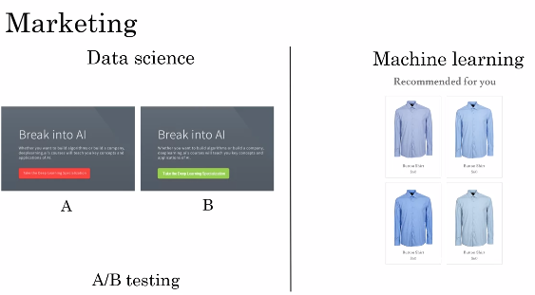
Every job function needs to learn how to use data
Notes:
How about machine learning and marketing? Today a lot of websites will give customized product recommendations to show you the things you're most likely to want to buy and this actually significantly increases sales on these websites. For example, a clothing website after seeing the way I shop after while, will hopefully just recommend blue shirts to me because that's frankly pretty much the only type shirt I ever buy, but maybe other customers will have more diverse and more interesting recommendations than mine But today these customized product recommendations actually drive a large percentage of sales on many large online e-commerce websites.

Slide 101
Every job function needs to learn how to use data
One last example from a totally different sector. Let's say you work in agriculture.
Maybe you're a farmer working on the light industrial farm, how can data science help you?
Today farmers are already using data science for crop analytics, where you can take data on the soil conditions, the weather conditions, the presence of different crops in the market and have data science teams make recommendations to what to plant, when to plant so as to improve use while maintaining the condition of the soil on your farm.

Slide 102
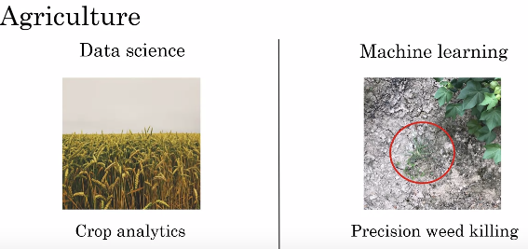
Every job function needs to learn how to use data
Notes:
This type of data science is and will play a bigger and bigger role in agriculture. Let's also look at the machine learning example. I think one of the most exciting changes to agriculture is precision agriculture. Here's a picture that I took on a farm with my cell phone. On the upper right is a cotton plants and shown in the middle is a weed. With machine learning, we're starting to see products that can go onto the farms, take a picture like this and spray a weed killer in a very precise way just onto the weeds so that it gets rid of the weed but without having to spray an excessive amounts of weed killers. This type of machine learning technology is both helping farmers increase crop yields while also helping to preserve the environment.

Slide 103
Every job function needs to learn how to use data
In this, you saw how all of these job functions, everything from sales, recruiting to marketing to manufacturing to farming agriculture, how all of these job functions are being affected by data, by data science and machine learning.
It seems like there's a lot of different things you could do with AI. But how do you actually select a promising project to work on? Let's talk about that in the next.

Slide 104
Building AI Projects? How to choose an AI project (Part 1)

Slide 105
How to choose an AI project (Part 1)
If you want to try your hand at an AI project, how do you select a worthwhile project to work on? Don't expect an idea to naturally come overnight.
Sometimes it happens, but sometimes it also takes a few days or maybe a few weeks to come up with a worthy idea to pursue. Next, you will see a framework for brainstorming potentially exciting AI projects to pursue.

Slide 106

How to choose an AI project (Part 1)
Let's say you want to build an AI project for your business. You've already seen that AI can't do everything, and so there's going to be a certain set of things that is what AI can do.
So let's let the circle represent the set of things that AI can do. Now, there's also going to be a certain set of things that is valuable for your business.
Notes:
So let's let this second circle represent a set of things that are valuable for your business. What you would like to do is try to select projects that are at the intersection of these two sets, so you select projects hopefully that are both feasible, that can be done with AI, and that are also valuable for your business. So AI experts will tend to have a good sense of what is and what isn't in the set on the left.

Slide 107

How to choose an AI project (Part 1)
Notes:
And domain experts, experts in your business, be it sales and marketing, or agriculture or something else, will have the best sense of what is actually valuable for your business. So when brainstorming projects that AI can do and are valuable for your business, I will often bring together a team comprising both people knowledgeable of AI, as well as experts in your business area to brainstorm together. So that together they can try to identify projects at the intersection of both of these two sets. So sometimes we also call these cross-functional teams, and that just means a team that includes both AI experts, as well as domain experts, meaning experts in your area of business.

Slide 108
How to choose an AI project (Part 1)
When brainstorming projects, there's a framework that I've used with a lot of companies that I found to be useful.
So let me share with you three principles or three ideas for how you can have a team brainstorm projects
First, even though there's been a lot of press coverage about AI automating jobs away, and this is an important societal issue that needs to addressed, when thinking about concrete AI projects, I find it much more useful to think about automating tasks rather than automating jobs

Slide 109

How to choose an AI project (Part 1)
Notes:
Take call center operations, there are a lot of tasks that happen in a call center.

Slide 110
How to choose an AI project (Part 1)
Ranging from people picking up the phone to answering phone calls to replying to emails, to taking specific actions, such as issuing a refund on behalf of a customer request.
But of all of these tasks that employees in a call center do, there may be one, call routing or email routing, that maybe particularly amenable to machine learning automation.
And it's by looking at all these tasks that the group of employees do and selecting one that may allow you to select the most fruitful project for automation in the near term.

Slide 111
How to choose an AI project (Part 1)
Let's look at another example, the job of a radiologist. There's been a lot of press about how AI my automate radiologists' jobs, but radiologists actually do a lot of things.
They read x-rays, that's really important, but they also engage in their own continuing education.
They consult with other doctors, they may mentor younger doctors, some of them also consult directly with patients.

Slide 112
How to choose an AI project (Part 1)
And so it's by looking at all of these tasks that a radiologist does that you may Identify one of them, let's say AI assistance or AI automation for reading x-rays, that allows you to select the most fruitful projects to work on.
So what I would recommend is, if you look at your business, think about the tasks that people do, to see if you can identify just one of them, or just a couple of them, that may be automatable using machine learning.

Slide 113

How to choose an AI project (Part 1)
Notes:
When I'm meeting CEOs of large companies to brainstorm AI projects for the company, a common question I'll also ask is, what are the main drivers of business value? And sometimes finding AI solutions or data science solutions to augment this can be very valuable. Finally, a third question that I've asked that sometimes let to valuable project ideas is, what are the main pain points in your business? Some of them could be solved with AI, some of them can't be solved with AI. But by understanding the main pain points in the business, that can create a useful starting point for brainstorming AI projects as well.

Slide 114
How to choose an AI project (Part 1)
I have one last piece of advice for brainstorming AI projects, which is that you can make progress even without big data, even without tons of data.
Now don't get me wrong, having more data almost never hurts, other than maybe needing to pay a bit more for disk space or network bandwidth to transmit and store the data, having more data almost always is only helpful.
Notes:
And I love having lots of data. It is also true that data makes some on businesses, like web search, defensible. Web search is a long tail business, meaning that there are a lot of very, very rare web queries.

Slide 115

How to choose an AI project (Part 1)
Notes:
And so seeing what people click on when they search on all of these rare web queries does help the leading web search engines have a much better search experience. So big data is great when you can get it, but I think big data also sometime over-hyped, and even with a small dataset, you can still often make progress.
Here's an example, let's say you're building a automated visual inspection system for the coffee mug. So you want to automatically detect that the coffee mug on the right is defective. Well, if you had a million pictures of good coffee mugs and defective coffee mugs, it'd be great to have that many examples of pictures of good and bad coffee mugs to feed your AI system.

Slide 116
How to choose an AI project (Part 1)
But I hope you have not manufactured 1 million defective coffee mugs, because that feels like a very expensive thing to have to throw away.
So sometimes with as few as 100, or maybe 1,000, or sometimes maybe as few as 10, you may be able to get started on the machine learning project.
The amount of data you need is very problem dependent, and speaking with an AI engineer or AI expert would help you get better sense.
Notes:
There are some problems where 1,000 images may not be enough, where you do need big data to get good performance. But my advice is, don't give up just because you don't have a lot of data to start off with. And you can often still make progress, even with a small dataset.

Slide 117
How to choose an AI project (Part 1)
In this, you saw a brainstorming framework, and a set of criteria for trying to come up with projects that hopefully can be doable with AI, and are also valuable for your business.
Now, having brainstormed a list of projects, how do you select one or select a small handful to actually commit to and work on? Let's talk about that in the next slides.

Slide 118
Building AI Projects? How to choose an AI project (Part 2)

Slide 119
How to choose an AI project (Part 2)
Maybe you have a lot of ideas for possible AI projects to work on. But before committing to one, how do you make sure that this really is a worthwhile project?
If it's a quick project that might take you just a few days maybe just jump in right away and see if it works or not, but some AI projects may take many months to execute.
In this, I want to step you through the process that I use to double-check if a project is worth that many months of effort.
Notes:
Let's take a look

Slide 120
How to choose an AI project (Part 2)
Before committing to a big AI project, I will usually conduct due diligence on it. Due diligence has a specific meaning in the legal world.
But informally, it just means that you want to spend some time to make sure what you hope is true really is true.
You've already seen how the best AI projects are ones that are feasible. So, it's something that AI can do, as well as valuable.

Slide 121

How to choose an AI project (Part 2)
Notes:
We really want to choose projects to that the intersection of these two sets. So, to make sure a project is feasible, I will usually go through technical diligence, and make sure that the project is valuable, I will usually go through a business diligence process. Let me tell you more about these two steps.

Slide 122
How to choose an AI project (Part 2)
Technical diligence is the process of making sure that the AI system you hope to build really is doable, really is feasible.
So, you might talk to AI experts about whether or not the AI system can actually meet the desired level of performance.

Slide 123

How to choose an AI project (Part 2)
Notes:
For example, if you are hoping to build a speech system that is 95 percent accurate, consulting of AI experts or perhaps reading some of the trade literature can give you a sense of whether this is doable or not. Or if you want a system to inspect coffee mugs in a factory and you need your system to be 99 percent accurate. Again, is this actually doable with today's technology? A second important question for technical diligence is how much data is needed to get to this desired level of performance, and do you have a way to get that much data. Third, would be engineering timeline to try to figure out how long it will take and how many people it will take to build a system that you would like to have built. In addition to technical diligence, I will often also conduct business diligence to make sure that the project you envision really is valuable for the business.
So, a lot of AI projects will drive value through lowering costs. For example, by automating a few tasks or by squeezing more efficiency onto the system. A lot of AI systems can also increase revenue. For example, driving more people to check out in your shopping cart or you may be building an AI system to help you launch a new product or a new line of business. So, business diligence is the process of thinking through carefully for the AI system that you're building such as a speech recognition system that's 95 percent accurate or a visual inspection system that's 99.9 percent accurate, would allow you to achieve your business goals. Whether your business goal is to improve your current business or to even create brand new businesses in your company. When conducting business diligence, I'll often end up building spreadsheet financial models to estimate the value quantitatively such as estimate how many dollars are actually saved or what do we think is a reasonable assumption in terms of entries revenue, and to model out the economics associated with a project before committing to many months of effort on a project.

Slide 124
How to choose an AI project (Part 2)
Although not explicitly listed on this slide, one thing I hope you also consider doing as a third type of diligence which is ethical diligence.
I think there are a lot of things that AI can do that will even make a lot of money, but that may not make society better off. So, in addition to technical diligence and business diligence, I hope you also conduct ethical diligence and make sure that whatever you're doing is actually making humanity and making society better off.
Notes:
We'll also talk more about this in the last in this course as well.

Slide 125
How to choose an AI project (Part 2)
As you're planning out your AI project, you also have to decide do you want to build or buy? This is an age old question in the IT world and we're facing this question in AI as well.
For example, hardly any companies build their own computers these days. They buy someone else's computers and hardly any companies build their own Wi-Fi routers, just buy a commercial Wi-Fi router. How about machine learning and data science?

Slide 126

How to choose an AI project (Part 2)
Notes:
AI translation playbook in greater detail later. Unlike machine learning projects though, data science projects are more commonly done in-house. They're not impossible to outsource, you can sometimes outsource them, but what I've seen is that data science projects are often so closely tied to your business that it takes very deep day-to-day knowledge about your business to do the best data science projects. So, just as a percentage, as a fraction, I see data science projects in-house more than machine learning projects. Finally, in every industry some things will be industry standard and you should avoid building those. A common answer to the build versus buy question was, build the things that are going to be quite specialized to you or completely specialized to you or they'll allow you to build a unique defensible advantage but the things that will be industry standard probably some other company will build and it'll be more efficient for you to just buy it rather than build it in-house. One of my teams have a really poetic phrase which is, "Don't sprint in front of a train," and what that means is, if this is a train running on a railway tracks and that's the small chimney with the puff of smoke. What you don't want to do is to be the person or the engineer trying to sprint faster and faster ahead of the train. The train is the industry standard solution, and so, if there's a company maybe a startup, maybe a big company or maybe an open-source effort that is building an industry standard solution, then you may want to avoid trying to run faster and faster to keep ahead of the train. Because even though you could sprint faster in the short term, eventually the train will catch up and crash someone trying to sprint in front of a train.

Slide 127
How to choose an AI project (Part 2)
So, when there's a massive force of an industry standard solution that is been built, you might be better off just embracing an industry standard or embracing someone else's platform rather than trying to do everything in-house.
We all live in a world of limited resources, limited time, limited data, limited engineering resources, and so, I hope you can focus those resources on the projects with our most unique and will make the biggest difference to your company.

Slide 128
How to choose an AI project (Part 2)
Through the process of technical diligence as well as business diligence, I hope you can start to identify projects that are potentially valuable or that seem promising for your business.
If the project is a big company, maybe it'll take many months to do. It's not unusual for me to spend even a few weeks conducting this type of diligence before committing to a project.
Notes:
Now, say you found a few promising projects, how do you engage with an AI team? How do you work with an AI team to try to get these projects done? Let's talk about that in the next .

Slide 129
Building AI Projects? Working with an AI team

Slide 130
Working with an AI team
Say you found an exciting project that you want to try to execute on, how do you work with an AI team on this project?
In this, you learn how AI teams think about data and therefore how you can interact with AI teams to help them succeed on a project.
Now, there is one caveat which is, whether you have a cool idea but you don't have access to an AI team, you don't have any access to any AI engineers.
Notes:
Fortunately in today's world, if either yourself or you can encourage some of your engineering friends to take an online course or two on machine learning or deep learning that often will give them enough knowledge to get going and make a start of an attempt, make a reasonable attempt on these types of projects. So, let's talk about how you can work with an AI team.

Slide 131
Working with an AI team
First, it really helps your AI team if you can specify an acceptance criteria for the project. I've done a lot of work in automated vision inspection.
So, I'm going to use that as a running example in these few slides. Let's say your goal is to detect defects in coffee mugs with at least 95% accuracy.

Slide 132

Working with an AI team
Notes:
So, that can be your acceptance criteria for this project. But 95% accuracy, how do you measure accuracy? One of the things that AI team would need is a dataset on which to measure the accuracy. So, dataset is just a set of pictures like these together with the labels, with the design output B that the first two coffee mugs are okay and the third one is defective.
So, as part of your specification for the acceptance criteria you should make sure that the AI team has a dataset on which to measure the performance so that they can know if they've achieved 95% accuracy. The formal term for this dataset is called a test set. The test set may not need to be too big, maybe a 1,000 pictures will be just fine for this example. But, if you consult with an AI expert they can give you a better sense of how big the test set needs to be for them to be able to evaluate whether or not they're getting to 95% accuracy. One novel part of AI systems is that their performance is usually specified in a statistical way. So, rather than asking for an AI system that just does something perfectly you see very often that we want an AI system that performs at a certain percentage accuracy like this example here. So, when specifying your acceptance criteria think of whether your acceptance criteria needs to be specified in a statistical way where you specify on average hour does or what percent of time it has to get the right answer.

Slide 133
Working with an AI team
Let's dive more deeply into the concept of a test set. This is how AI teams think about data. AI teams group data into two main datasets.
The first called the training set and the second called the test set which we've already talked a bit about.
The training set is just a set of pictures together with labels showing whether each of these pictures is of a coffee mug that is okay or defective.

Slide 134

Working with an AI team
Notes:
So, the training set gives examples of both the input A the pictures of the coffee mugs as well as the desired output B whether it's okay or defective. So, given this training set what a machine learning algorithm will do is learn in other words computes or figure out some mapping from A to B so that you now have a piece of software that can take as input the input A and try to figure out what is the appropriate output B. So, the training set is the input to the machine learning software that lets it figure out what is this A to B mapping. The second dataset that an AI team will use is the test set. As you've seen this is just another set of images that's different from the training sets also with the labels provided. The way an AI team will evaluate their learning algorithms performance is to give the images into the test set to the AI software and see what the AI software outputs.
For example, if on this three test set images the AI software outputs okay for this, okay for this, and also okay for this, then we will say that they got two out of three examples right and so that's a 66.7% accuracy. In this figure the training set and test set above have only three pictures, in practice both of these datasets would be much bigger of course. You find that for most problems the training set is much bigger than the test set.
But you can talk to AI engineers to find out how much data they need for a given problem. Finally, for technical reasons some AI teams will need not just one but two different test sets. If you hear AI teams talk about development or deaf or validation tests that's the second test set that they're using. The reasons why they need two test set is quite technical and beyond the scope of this course, but if an AI team asks you for two different test sets it's quite reasonable to try to provide that to them

Slide 135
Working with an AI team
Before wrapping up this lesson one pitfall I want to urge you to avoid is expecting a 100% accuracy from your AI software.
Here's what I mean, let's say this is your test set which you've already seen on the last slide.
But, let me add a few more examples to this test set. Here are some of the reasons it may not be possible for a piece of AI software to be a 100% accurate.

Slide 136
Working with an AI team
First, machine learning technology today despite being very powerful still has limitations and they just can't do everything. So, you may be working on a problem that it's just very difficult even for today's machine learning technology.
Second, insufficient data. If you don't have enough data specifically if you don't have enough training data for the AI software to learn from it may be very difficult to get a very high level of accuracy.
Third, data is messy and sometimes data can be mislabeled
Notes:
For example, this green coffee mug here looks perfectly okay to me, so, the label of it being a defect looks like an incorrect label and that would hurt the performance of your AI software. Data can also be ambiguous. For example, it looks like this coffee mug has a small scratch over there and it's a pretty small scratch, so, maybe we will think of this though okay.

Slide 137

Working with an AI team
Notes:
But maybe this should actually have been a defect or maybe even different experts won't agree if this particular coffee mug is okay and should pass the inspection step. Some of these problems can be ameliorated. For example, if you don't have enough data maybe you can try to collect more data and more data will often help. Or you can also try to clean up mislabeled data or try to get your factories experts to come to better agreement about these ambiguous labels. So, there are ways to try to make these things better, but, a lot of AI systems are incredibly valuable even without achieving a 100% accuracy. So, I will urge you to discuss with your AI engineers what is a reasonable level of accuracy to try to accomplish? Then try to find something that passes both technical diligence as well as business diligence without necessarily needing a 100% accuracy.

Slide 138
Working with an AI team
You now know what it feels like and what it takes to build an AI project.
I hope you e start brainstorming and exploring some ideas. There is one more optional lesson describing some of the technical tools that AI teams use that you can watch if you wish.
Notes:
But either way I look forward to seeing you next, where you'll learn how AI projects fit in the context of a bigger company.

Slide 139
Building AI Projects? Technical tools for AI teams (optional)

Slide 140
Technical tools for AI teams (optional)
When you work with AI teams, you may hear them refer to the tools that they're using to build these AI systems.
In this, I want to share with you some details and names of the most commonly used AI tools, so that you'd be able to better understand what these AI engineers are doing.

Slide 141
Technical tools for AI teams (optional)
We're fortunate that the AI world today is very open, and many teams will openly share ideas with each other.
There are great machine learning open source frameworks that many teams will use to build their systems. So, if you hear of any of these: TensorFlow, PyTorch, Keras, MXNet, CNTK, Caffe, PaddlePaddle, Scikit-learn, R or Weka, all of these are open source machine learning frameworks that help AI teams be much more efficient in terms of writing software.

Slide 142
Technical tools for AI teams (optional)
Along with AI technology breakthroughs are also publish freely on the Internet on this website called Arxiv.
Spelled like this. I hope that other academic communities also freely share their research since I've seen firsthand how much this accelerates progress in the whole field of AI.
Finally, many teams will also share their code freely on the Internet, most commonly on a website called GitHub.

Slide 143


Technical tools for AI teams (optional)
Notes:
This has become the de facto repository for open source software in AI and in other sectors in AI. And by using appropriately licensed open-source software, many teams can get going much faster than if they had to build everything from scratch.

Slide 144


Technical tools for AI teams (optional)
Notes:
So, for example, if I search online for face recognition software on GitHub, you might find a web page like this. And if you scroll down, this actually has a pretty good, very readable description of software that is made available on this website for recognizing people's faces, and even finding parts of people's faces. There's just a ton of software that is freely downloadable for doing all sorts of things on the Internet, and just double-check the license, or AI team will double-check the license before using it in a product of course, but a lot of these software is open source, or is otherwise very permissively license for anyone to use. Although GitHub is a technical website built for engineers, if you want you should feel free to play around GitHub and see what are the types of AI software people have released online as well.

Slide 145

Technical tools for AI teams (optional)
Notes:
In addition to these open source technical tools, you often also hear AI engineers talk about CPUs and GPUs. Here's what these terms mean. A CPU is the computer processor in your computer, whether it's your desktop, your laptop, or a computer server off in the Cloud. CPU stands for the central processing unit, and CPUs are made by Intel, and AMD, and a few other companies. This does a lot of the computation in your computer. GPU stands for graphics processing unit. Historically, the GPU was made to process pictures. So, if you play a video game, it's probably a GPU that is drawing the fancy graphics. But what we found several years ago was that the hardware that was originally built for processing graphics turns out to be very, very powerful for building very large neural networks. So very large deep learning algorithms. Given the need to build very large deep learning or very large neural network systems, the AI community has had this insatiable hunger for more and more computational power to train bigger and bigger neural networks. And GPUs have proved to be a fantastic fit to this type of computation that we need to have done to train very large neural networks. So, that's why GPUs are playing a big role in the rise of deep learning. And video is company that's been selling many GPUs. But other companies including Qualcomm, as well as Google making his own CPUs are increasingly making specialized hardware for powering these very large neural networks. Finally, you might hear about Cloud versus On-premises, or for short, On-prem deployments. Cloud deployments refer to if you rent compute servers such as from Amazon's AWS, or Microsoft's Azure, or Google's GCP in order to use someone else's service to do your computation. Whereas, an On-prem deployment means buying your own compute servers and running the service locally in your own company. A detailed exploration of the pros and cons of these two options is beyond the scope of this lesson.

Slide 146
Technical tools for AI teams (optional)
A lot of the world is moving to Cloud deployments. Whether you search online you find many articles talking about the pros and cons of Cloud versus On-prem deployments.
There is one last term you might hear about, which is Edge deployments.
If you are building a self-driving car, there's not enough time to send data from a self-driving car to a Cloud server to decide if you should stop the car or not, and then send that message back to the self-driving car.
Notes:
So, the computation has to happen usually in a computer right there inside the car. That's called an edge deployment, where you put a processor right where the data is collected so that you can process the data and make a decision very quickly without needing to transmit the data over the Internet to be processed somewhere else. If you look at some of the smart speakers in your home as well, this too is an edge deployment where some, not all, but some of the speech recognition task is done by a processor that is built in right there into this smart speaker that is inside your home. The main advantage of Edge deployment is it can increase response time of the system, and also reduce the amount of data you need to send over the network. But there are many pros and cons as well about Edge versus Cloud versus On-prem deployments that you can also search online to read more about.

Slide 147
Technical tools for AI teams (optional)
Thanks to finishing this optional Slides on the technical tools that AI engineers use.
Hopefully, when you hear them refer to some of these tools, you'll start to have a better sense of what they mean.

Slide 148
Building AI In Your Company? Introduction

Slide 149
Introduction
We'll look at the projects we talked about already, and talk about how projects fit in the context of a company. Whether it's a for-profit, non-profit, or even within a government entity.
For the sake of concreteness, I'll talk about building AI for companies will equally apply, no matter what type of organization you're in.

Slide 150
Introduction
Now, in case some of what you hear this lesson sounds like CEO level talk, don't be intimidated.
This is actually useful for everyone to know, the ones that hope, your company will help your organization Improve using AI.
And it does take maybe two or three years for a company to become good at AI.
Notes:
To embrace not just one AI project but a sequence of valuable AI projects and become much more effective. But what I hope to do this lesson is help you paint a vision for where an organization can go over a longer period of time like that. But also end the lesson with very concrete short steps you can take right away..

Slide 151

Introduction
Notes:
So let's get started. In detail, these are the topics you'll see this lesson. First is case studies of complex AI products So rather then a single machine learning or data science module like what you saw last lesson. This lesson you'll see you how multiple modules can come together to build a much more complex AI product such as a smart speaker or a self driving car. You also learn what are the major roles in an AI team. So if ever you think your company can build a large AI team with maybe many dozens or maybe even hundreds of people, what are the things these people will do?
We'll start to paint a roadmap for what building an AI team might look like. Third you also learn about the AI transformation playbook of how to help your company become good at AI. Where it goes beyond doing one or two valuable projects, but about making a whole company good at AI and hopefully much more effective and valuable as a result. Finally, whereas some of these steps may take a small number of years to complete.

Slide 152
Introduction
We'll wrap these lessons with concrete suggestions on how you can take your first step, right away, toward building AI in your company.
Beyond these major topics, we'll also have a couple of optional lessons at the end, where you see a survey of major AI application areas and techniques.
Notes:
So, after this lecture, I hope you have a good vision of how you can help your company use AI and also have first steps you can take right away. Lets get started by going on to the next lesso.

Slide 153
Building AI In Your Company? Case study: Smart speaker

Slide 154
Case study: Smart speaker
What does it feel like to work on a complex AI product, where isn't just using a single machine learning algorithm to map from A to B, but that learning algorithm is part of a bigger more complex project or product.
I want to start it this lesson with two case studies of building complex AI products.
First, building a smart speaker so that you can start to understand whether my feel like to maybe someday work on a complex AI product within your own company.

Slide 155
Case study: Smart speaker
Let's get started. Smart speakers and voice activated devices like these are taking the world by storm and if you don't already have one in your home, maybe you buy one someday.
I'd like to go through a case study of how you would write AI software to get a smart speaker to respond to a verbal command such as "Hey device, tell me a joke.

Slide 156
Case study: Smart speaker
" For this example, rather than using Alexa, or Okay Google, or Hey Siri, or Hello Baidu as the wake word or trigger word, to be more device agnostic, I'm just going to use "Hey device" as the trigger word or wake work.
To wake up say a smart speaker and let's say you wanted to tell you a joke.
So how do you build a piece of AI software to understand a command like this and executes on it? These are the steps needed to process the command.

Slide 157

Case study: Smart speaker

Slide 158
Case study: Smart speaker
There can be four steps. Step one is the trigger word or the wake word detection.
The speaker uses a machine learning algorithm to input the audio clip and output.
Did they just hear the wake word or the trigger word "Hey Device," so o plus 0 or one and once it hears the trigger word or wake word, once it hears "Hey device," it then has to perform step two, which is speech recognition.
So what the software has to do is take the audio of what came after "Hey device" and map that to "Tell me a joke."

Slide 159

Case study: Smart speaker
Notes:
This is also done with machine learning. Whereas, the first step here used an A to B mapping to just tell it that it hear the trigger word. This uses a different A to B mapping to map the audio to a text transcript of what you just said, which in this case is the four words tell me a joke. Now, the algorithm has to figure out what you actually want by saying these four words and so the third step is intent recognition. That means to take what have you said and to figure out what you actually wanted to do. So today's smart speakers have a limited set of commands such as they can tell a joke or they can tell the time. So you can say "Hey device what time is it." They can play music. They can sometimes help you make a phone call. They can tell you what's the weather, "Hey device, what's the weather tomorrow?"
So what intent recognition does, is take the four words, the speech recognition's output, and use another piece of AI software, another A to B mapping that inputs those four words and outputs which of these five or other intents do you have. So in this implementation of a machine learning algorithm, the input A is the text transcript tell me a joke and the output B is which of these five types of commands did the user just utter. Of course, your smart speaker may be more understand even more commands than just these five, in which case B would be whichever of the five or 20 or 100 commands your smart speaker knows how to execute. No matter how you ask the smart speaker to tell you a joke, hopefully, the intent recognition components will recognize your intent correctly. So that you can also say not just "Hey device, tell me a joke," but also "Hey device, do you know any good jokes" or "Hey device, tell me something funny." Turns out, there are lot of ways for you to ask a smart speaker for a joke and a well-designed intent recognition system should recognize most of them. Finally, now that your smart speaker has figured out that you really, really want to hear a joke, the last step is that there will be a software engineer that has written a piece of code to randomly select a joke and to play the joke back through the speaker

Slide 160


Case study: Smart speaker
Notes:
In other words, they'll execute a joke. Just for the record, my favorite joke is why are there so me shocking results in AI, because AI is the new electricity, shocking electricity, get it? Hope you enjoyed that. So, all right, and in seriousness, you can think of the four steps of the algorithm as these four steps, where the first step is trigger word detection, second step, speech recognition, then intent recognition, and then finally, execution of what are the command the user asked the smart speaker to execute. So the process of having four steps in an AI system like this or multiple steps, this is sometimes called an AI pipeline, where you have multiple AI components. Yes, it's possible machine learning components which process data one step after another and it would not be unusual to have say, four different teams in the company where each team focuses on one of the components of this AI pipeline. That's how we often organize projects within a large company. Let's now look at a more complex example.

Slide 161
Case study: Smart speaker
One of you issue a more complex commands like "Hey device, set timer for 10 minutes."
These are the steps needed to process a command. First step, same as before is trigger word detection.
So input an audio and just let me know when someone said the trigger word hey device.
Notes:
That's how we often organize projects within a large company. Let's now look at a more complex example. One of you issue a more complex commands like "Hey device, set timer for 10 minutes."

Slide 162

Case study: Smart speaker
Notes:
These are the steps needed to process a command. First step, same as before is trigger word detection. So input an audio and just let me know when someone said the trigger word hey device. Then speech recognition, where you input the rest of the audio and transcribe the rest of the sound, the rest of the audio, set timer for 10 minutes and now, intent recognition has to input that texts and output that your intent is that you want to set a timer. One difference between set timer for 10 minutes compared to the earlier example of tell me a joke is that you need to know how long to actually set the timer for.
So in the execution step, you actually need to do two things. One is extract the duration. That means, look at the text, set timer for 10 minutes and pull out the phrase that tells you how long to actually set the timer for and so if the user were to say "Hey device, let me know when 10 minutes is up" then this extract duration step would have to pull out again, the 10 minute phrase right there and of course, there are lots of ways to ask for a 10-minute timer. You can also say, let me know when 10 minutes are up or set an alarm for 10 minutes from now and hopefully, the intent recognition and extract duration components will both be robust enough to recognize that all of these are different ways of asking for a 10-minute timer. Finally, to execute the command, there should be a specialized software components in the smart speaker that can start a timer with a set duration and after it has extracted your intent and the duration, it just start the timer with that duration. So that the alarm goes off at the end of 10 minutes. Today's smart speakers have many functions.

Slide 163
Case study: Smart speaker
Today's smart speakers have many functions.
Other than the two we've talked about of telling jokes and setting a timer, here are some other functions that many smart speakers today can execute and the key steps of executing these commands are trigger word or the wake word detection, speech recognition to transcribe the text in the command, intent recognition to figure out which of these functions or which of these commands you want to execute, and then a specialized program to execute whichever command you uttered

Slide 164

Case study: Smart speaker
Notes:
One of the challenges of the smart speaker world is that, if you want your smart speaker to have this many different functions say, 20 different functions, then you do need software engineering teams to write 20 specialized pieces of software. One to play music, one to set the volume, one to make calls, one to ask what's the current time, one to convert units like from teaspoons to tablespoons, or to answer very simple questions, and on and on. So it's actually quite a lot of work to write all of these specialized programs to execute all the different commands you might want to execute in step four and smart speakers today actually do so many things that is difficult for many users to cue straight in their heads exactly what they can and cannot do. So many smart speaker companies have been investing a lot in user training to try to let users know what are the things that smart speakers can do because on one hand, they can't do everything. There are lot of things you can't ask smarts speakers to do such as please call all of my three friends and see when all of them are able to meet for dinner.

Slide 165
Case study: Smart speaker
So it's been an ongoing processes of smart speaker companies to explain to users what they can and cannot do.
Nonetheless, with what they can do using voice to command these speakers is making life much more convenient for many people.

Slide 166
Case study: Smart speaker
I hope this gave you a sense of what it takes to build a complex AI product such as a smart speaker.
In order to help you better understand how these complex products work, let's go on to see a second case study of how to piece together multiple AI components to build a self-driving car.
Notes:
Let's go on to the next slides.

Slide 167
Building AI In Your Company? Case study: Self-driving car

Slide 168
Case study: Self-driving car
One of the most exciting products of the AI era is the self-driving car.
Self-driving cars are also one of the most mysterious things you hear about in AI these days.
In this what I want do is share with you a somewhat simplified description of a self-driving car so that you understand how you can piece together multiple AI components in order to build these amazing things.

Slide 169
Case study: Self-driving car
Let's get started. These are the key steps for deciding how to drive your self-driving car.
The car will take as input various sensors such as pictures of what's in front of the car or to the sides or behind, as well as maybe radar or Lidar meaning laser sensor readings.
Given these inputs of a picture(next slide) and maybe other things, it then has to detect other cars.

Slide 170

Case study: Self-driving car
Notes:
So given that, hopefully, you'll figure out there's a car there, as well as where are the pedestrians, because we want to avoid other cars as well as avoid pedestrians. Both car detection and pedestrian detection can be done with machine learning using input/ output or A to B mappings that takes as input the picture and maybe radar and Lidar, sends the inputs and tells us where are the other cars and pedestrians. Finally, now that you know where are the other cars and where are the pedestrians, you can then feed this information into another specialized piece of software, it's called a motion planning piece of software that plans the motion or plans the path that you want your car to take, so that you can make progress to your destination while avoiding any collisions. Once you've planned out the motion for your car, you can then translate that into specific steering angle for your steering wheel and acceleration and brake commands, so how much to step on the gas pedal, and how much to brake in order to get your car to move at the desired angle as well as speed

Slide 171
Case study: Self-driving car
Let's look at the three key steps of car detection, pedestrian detection, and motion planning in more detail.
Car detection uses supervised learning. So, you've already seen how a learning algorithm can take as input pictures like these and output the detected cars.
For most self-driving cars rather than using only a front-facing camera, so a camera that looks forward, also often use cameras that look to the left, to the right as well as to the back so it can detect cars not just to the front but all around it.

Slide 172

Case study: Self-driving car
Notes:
This is usually done using not just cameras but other sensors as well such as radar and Lidar. Next is pedestrian detection, and using a pretty similar type of sensors as well as techniques, self-driving cars can detect pedestrians. Finally, I briefly mentioned a motion planning step. So, what is that? Here's an example.
Let's say you're driving your car and there's this light blue car in front of you. The motion planning software's job is to tell you what is the path, shown here in red, you should drive in order to follow the road and not have an accident. So the motion planning software's job is to output the path as well as speed at which you should drive your car in order to follow the road, and the speed should be set so that you don't run into the other car, but you also drive at a reasonable speed on this road Here's another example. If there's this gray car parked on the right side of the road, so you want to overtake this stopped car, then the motion planning software's job is to plot a path like that to let you veer a little bit to the left and safely overtake a stopped car. So far I've given a rather simplified description of self-driving as comprising mainly these three components.

Slide 173
Case study: Self-driving car
Let's look at a bit more detail of how an actual self-driving car might work.
This is a picture you've seen so far. Input image, radar, or Lidar, sensor readings into car detection and pedestrian detection, and that is then fed to motion planning to help you select your path and speed.
Now in a real self-driving car, you would usually use more than just cameras, radar, and Lidar.

Slide 174

Case study: Self-driving car
Notes:
Most self-driving cars today will also use GPS to sense its position as well as accelerometers, sometimes called an IMU, this means accelerometers, and gyroscopes as well as a map because we know that cars are more likely to be found on a road, pedestrians are more likely to be found on sidewalks, although they are sometimes found on the road as well. All this is usually additional information that's fed in to detect cars and pedestrians as well as other objects we'll talk about in a second. Rather than just detecting cars and pedestrians, in order to drive safely you also need to know where these cars and pedestrians are going in the future. So, another common component of self-driving cars is trajectory prediction, where there's another AI component that tells you not just the cars and pedestrians you found, but also where they're likely to go in the next few seconds, so you can avoid them even as they're moving. To drive safely requires more than just navigating other cars and pedestrians. You also need to know where are the lanes so you might detect lane markings.
If there's a traffic light you also need to figure out where's the traffic light, and is it showing a red, yellow, or green signal. Sometimes there are other obstacles, such as unexpected traffic cones or maybe there's a flock of geese walking in front of your car. That needs to be detected as well so that your car can avoid even other obstacles than cars and pedestrians.

Slide 175
Case study: Self-driving car
On a large self-driving car team, it would not be that unexpected to have a team or maybe a few people working on each of the boxes shown here in red, and it's by building all of these components and putting them together that you can build a self-driving car.

Slide 176
Case study: Self-driving car
As you can tell both from this rather complex example of an AI pipeline, as well as the early example of the four-step AI pipeline for the smart speaker, sometimes it takes a team to build all of these different components of a complex AI product.
What I'd like to do in the next slides is share with you what are the key roles in large AI teams.
If you're either a one-person or small AI team now, that's okay, but I want you to have a vision of what building a large AI team, maybe in the distant future, might look like.
Notes:
Let's go on to the next slides.

Slide 177
Building AI In Your Company? Example roles of an AI team

Slide 178
Example roles of an AI team
You saw from the last that some AI products may require a large AI team, maybe you have a 100 engineers or sometimes many more than a 100 to build.
What I would like to do in this lesson is share with you the typical roles and responsibilities of a large AI team like this so you can better understand the types of work needed to build these complex AI products.
Notes:
Now, even if you will be working in a much smaller team, maybe a one or two or five person team for the foreseeable future, I hope this lesson will still be useful to you because I hope it'll give you a sense of the different types of work that an AI team might need to do even if you end up executing on this type of work with a much smaller team. One caveat, because AI is evolving so fast, the job titles and various responsibilities are not yet a 100 percent defined, and they are a little bit different across different companies So, your company may use their job titles differently than what I'm presenting here, but I want to share a view how job tittles are often used in many companies, so that if you're someday building up your own AI team, we hear about these roles you would have at least some deeper understanding of what these job titles mean.

Slide 179

Example roles of an AI team
Many AI teams will have Software Engineers in them. So, for example, for the smart speaker we needed to write specialized software to execute on the joke or to set a timer or to answer questions about today's weather.
So, those are traditional software engineering tasks. Or you're building a self-driving car to make sure that your self-driving car software is reliable and doesn't crash.
Notes:
These are software engineering tasks. So, it's not uncommon for AI teams to have enlarged fractions sometimes 50 percent, sometimes much much more than 50 percent of Software Engineers in them. The second common role is the Machine Learning Engineer. So, Machine Learning Engineer might write the software responsible for generating the A to B mapping or for building other machine learning algorithms needed for your product.
.

Slide 180


Example roles of an AI team
Notes:
So, they might gather the data of pictures of cars and positions of cars, train a neural network or train a deep learning algorithm and work iteratively to make sure that the learning algorithm is giving accurate outputs. Another role that you sometimes hear about is the Machine Learning Researcher. The typical row of the Machine Learning Researcher is to extend the state of the art in machine learning. Machine learning and AI more broadly are still advancing rapidly. So, many companies for profit and non-profit, more have Machine Learning Researchers responsible for extending the state-of-the-art. Some Machine Learning Researchers will publish papers, but many companies also have Machine Learning Researchers that do research, but are less focused on publishing. There's one other job title that's sort of in-between these two which is the Applied Machine Learning Scientists, which live somewhere between Machine Learning Engineer and Machine Learning Researcher. The Machine Learning Scientists kind of does a bit of both. They are often responsible for going to the academic literature or the research literature and finding the steady VR techniques and finding ways to adapt them to the problem they are facing such as how to take the most cutting edge, trigger where the wicker detection algorithm and adapt that to your smart speaker

Slide 181
Example roles of an AI team
Let's look at some more of those. Today, there are a lot of Data Scientists working in industries.
The role of Data Scientist is not very well defined and the meaning is still evolving today.
I think one of the primary responsibilities of Data Scientists is to examine data and provide insights, as well as to make presentations to teams or the executives in order to help drive business decision-making.
Notes:
There also Data Scientists today doing other tasks. So, there are also Data Scientists today whose work looks more like the Machine Learning Engineers, they are described on the previous slide. The meaning of this job title is still evolving today. With the rise of big data, there are also more and more Data Engineers whose main role is to help you organize your data, meaning, to make sure that your data is saved and is easily accessible, secure and cost-effective way.

Slide 182

Example roles of an AI team
Notes:
So, why is saving data such as a big deal? Can't you just save them in a hard disk and be done with it. In some companies, data volumes have gotten so big. There's actually quite a lot of work to manage them. To give you a sense of the scale, in computer science one MB stands for one megabytes and so a typical song on your music player like a typical MP3 file may be a few megabytes, say five megabytes would be a non unusual MP3 file size. A 1,000 megabytes is called a gigabyte. A million megabytes is called a terabyte and a billion megabytes is called a petabyte. With today's hard disk sizes, saving a few megabytes is not a big deal. It's just like a mere MP3 file, but storing a 1,000 megabytes, also called a gigabyte, starts to be a bit slower. A typical hour-long movie that you stream over the internet maybe above gigabytes. So, that's quite a lot of data. To give you a sense of the scale, a self-driving car may collect multiple gigabytes of information every single minute of operation So, it's as if every minute the self-driving car generates enough data to store multiple hour-long movies. So, self-driving cars actually generate lot of data and saving the data for many days or weeks or months or years of operation starts to require serious data engineering. A terabyte is 1,000 times bigger than that and a petabyte is yet another 1,000 times bigger than that of that teams that were responsible for saving several petabytes of information per day, but other than pretty large internet companies is not that common for a company to generate multiple petabytes of information per day. As you move down this scale to bigger and bigger datasets, it becomes harder and harder to make sure that data is stored in a easy accessible, secure and cost-effective way, which is why Data Engineers become more and more important.

Slide 183
Example roles of an AI team
Finally, you'll also hear some people referred to AI Product Managers whose job is to help decide what to build.In other words, they help to figure out what's feasible and valuable.
Traditional Product Manager's job was already to decide what to build as well as sometimes some other roles, but the AI Product Manager now has to do this in the AI era and they're needing new skill sets to figure out what's feasible and valuable in light of what AI can and cannot do today.
Notes:
Because the field of AI is still evolving, none of these job titles are completely nailed down in the stone and different companies will use these job titles somewhat differently. But I hope this gives you a sense of some of the different types of work needed to build very complex AI products as well as where some of the job titles are evolving.

Slide 184
Example roles of an AI team
So, whether you just have one Software Engineer working with you, or just a single Machine Learning Engineer, or just a single Data Scientists, or maybe nobody, but yourself, if either you or an engineer working with you has taken some online courses on machine learning or deep learning or data science, that's often enough for you by yourself or for you and an engineer to start looking at some smaller volumes of data, start drawing some conclusions or start trading some machine learning models to get going
Notes:
To finish though, I want to re-emphasize that you can get started with a small team. You don't need a 100 people to do most AI projects.

Slide 185

Example roles of an AI team
Notes:
So, even though I've tried to paint here a vision for what a large AI team might look like, even if you have only a small AI team, could be nobody by yourself, I would still encourage you to get started and start exploring what the projects you could do.

Slide 186
Example roles of an AI team
In this, you saw what an AI team might look like, but when you look at a bigger company, an AI team doesn't live in isolation.
So, how does an AI team fit into a bigger company to help the whole company become good at AI? You might remember that previously, I briefly alluded to an AI transformation playbook, which is a roadmap for you to help a company, to help maybe a great company become great at AI.

Slide 187
Example roles of an AI team
Now that you've learned what is AI, how to do AI projects and even what AI teams in companies and the competency AI projects and coms may look like, let's return to their AI transmission playbook and go much deeper into the individual steps of the playbook so that you can understand what it takes to help a company over maybe a small number of years become good at AI and hopefully become much more valuable and much more effective along the way.
Let's go into the AI transmission playbook in the next.

Slide 188
Building AI In Your Company? AI Transformation Playbook (Part 1)

Slide 189
AI Transformation Playbook (Part 1)
How can you help your company become good at AI? Based on my experience, starting leading the Google Brain Team as well as Baidu's AI group which were respectively the leading forces for helping Google and Baidu become good and deeper in AI.
I've spent a lot of time thinking about what it takes to help a great company become a great AI company and I wound up writing an AI transformation playbook to help other countries on this journey.
Notes:
In this, I'd like to share with you the details of the AI transformation playbook so that you can better understand what it might take for your company to become good at AI. In case some this seems like things that only CEO's need to know, I think that that's not the case, it's useful for everyone in the company to understand whether it might take for your work to impact not just a few projects but maybe have a bigger impact on the company as a whole. a bigger impact on the company as a whole.

Slide 190
AI Transformation Playbook (Part 1)
Here are the five steps of the AI transformation playbook. We'll dive into greater detail in a little bit but briefly, step one is for your company to execute pilot projects to gain momentum. Start to know what it feels like to work on AI projects.
Step two, is to build an in-house AI team.
Step three, is to provide broad AI training, not just the engineers but to many levels within a company including executives.
Notes:
Let's get started.

Slide 191
AI Transformation Playbook (Part 1)
Step four, is to develop your AI strategy and step five, is to develop internal and external communications about your company and AI.
The way your company will execute the steps may not be totally sequential and so the different steps may overlap. But this numbering gives a maybe rough sense of the order in which I think you could do these steps.
In this , we will go in greater depth on the first three of these three steps and the next lesson we'll cover steps for and five.

Slide 192

AI Transformation Playbook (Part 1)

Slide 193

AI Transformation Playbook (Part 1)
Notes:
Let's start with step one, executing pilot projects to gain momentum. If you want your company to gain momentum with AI, the most important consideration for the initial project or projects, is for them to be successful rather than necessarily be the most valuable.

Slide 194
AI Transformation Playbook (Part 1)
For example, when I was leading the Google Brain Team, there was still a lot of skepticism at that time about deep learning.
So, my first internal customer was Google's speech recognition team and speech recognition is nice to have this is useful but it's actually not the most important or valuable project for the company's bottom lines.
It's not as valuable as, for example web search or online appetizing.
Notes:
But by having my team make the Google Speech team more successful, it started the fly wheel turning helps it get momentum because then the peers and the other teams that are brothers and sisters the speech team started to see my team make the speech team more successful and so they also started to gain favor in AI and wanted to work with us. So, my second internal customer was the Google Maps Team to improving the quality of the maps data using deep learning and with the first second successes. I then started other conversations with the online advertising team for example.

Slide 195

AI Transformation Playbook (Part 1)
Notes:
So, when selecting your initial project, try to pick something that you think has a good chance of success. They can start to fly wheel turning even if it may not be the most valuable project that you could eventually do for the company. Because the goal of the first few projects is just to gain momentum is also now you see if you can pick something that can show traction within six to 12 months. So you can start to fly wheel turning quickly. Finally, your first one or two pilot projects can be either in-house or outsource. If you do not yet have a large in-house AI team, might be possible, might even be advisable to outsource some or all of your first couple of AI projects in order to get more expertise in house and to let you start building that momentum faster. Now, beyond a certain point, you will need your own in-house AI team to execute a long-term sequence of maybe many dozens of AI projects.

Slide 196

AI Transformation Playbook (Part 1)
Notes:
So, step two is to build an in-house AI team. A lot of companies are organized like this, where, there's a CEO and multiple business units which I'm going to abbreviate with BU that reports up to the CEO So, what I recommend for most companies is to build a centralized AI team and then to take the talent in the matrix organization and two matrix them into these different business units to support their work. Why essentialize the AI? Let's take an example. Maybe this unit is your gift card business unit, and the BU leader may be great at whatever he or she does. They may be greater than gift card business. But unless he or she is knowledgeable AI and knows how to build retain and nows how to build retain and managing AI team, it may be very difficult for that business unit leader to hire and retain an appropriately manage their own AI talent. So, in that case, I think you also successfully much higher if you find that AI team leader that can be responsible for consistent company wise standards for recruiting, retention. Have essentialized AI team to give the team the community to talk to each other about how AI applies to your business radical It may be more efficient to take the AI talent in your centralized AI unit and matrix them into the gift card business unit so that your AI talent can work together with the gift card domain experts in order to develop interesting AI projects together. One other responsibility for the AI unit, is to build a company wide tools or platforms that can help multiple business units. Finally, this new AI business unit can be under the CTO, the CIO, the chief data officer or the Chief Digital Officer or it could also be under a new chief AI officer. The CAIO chief AI officer is a role that I'm seeing more and more often in different companies but if some other senior executive has the right skill set, they could also manage the AI unit. Finally, one last recommendation, which is that, I think it is think it is hopeful if to get the AI units started the company or the CEO provides funding to build at the AI unit rather than required AI unit to get funding from the business units. Eventually, after the initial investment and after the initial ramp up, the AI unit will have to show his value that is creating for the business units but having CEO inject funding at the outset so they can get going, will often help you get that initial momentum much faster. In addition to building an in-house AI team, I also recommend that you provide broad AI training.

Slide 197

AI Transformation Playbook (Part 1)
Notes:
Now, for accompany that become good at AI, is not just that you need engineers to know AI, you need multiple people at multiple levels of the company to understand how AI interacts with their roles. For example, for executives and senior business leaders, I recommend that they learn what AI can do for your enterprise, that they learned the basics of these of AI strategy and they learned enough about AI to make resource allocation decisions. So, how much training should executives senior business leaders receive? I think that numbers of hours of training is not a very good way to measure training but with that caveat, I think you can deliver a lot of this training with maybe four hours or so of training. Leaders of divisions work on AI projects also need to know how to interact in their role with AI. I think these leaders would need to understand how to set project directions. So how the conduct technical and business diligence how to make resource allocation decisions at the division level as well as how to track and monitor progress of AI projects. So, this have a training I think would take at least 12 hours. Although, again number of hours is not a great metric for tracking how much are they earning. Finally, many companies are hiring AI talent from outside but I will also not underestimate the importance and the impact of training of your existing engineering workforce with AI skills for a software engineer to become proficient at AI does take a while so plan for maybe at least a 100 hours of training. But I'm seeing many companies provide training to help engineers learn to build and ship AI software to gather and managed data as was helped them become effective at executing on specific AI projects. The world today does not have nearly enough AI engineers and so in-house training is a key part of many companies building up of their in-house AI capabilities. Finally, how do you get all this training done? Thanks to the rise of online digital content, ranging from of course, online courses to also books and YouTube videos and blog posts.
There is a lot of great content online about all of these subjects and I think a good CLO should work of experts to curate this type of content and motivated teams to complete these learning activities rather than necessarily create contents which is much more expensive thing to do

Slide 198
AI Transformation Playbook (Part 1)
So steps one to three of the AI transmission favor. Okay, I hope that your company will be able to start to execute an initial projects, build the team, provide the training and really start to get a lot of momentum going in terms of helping you accompany you become more valuable or more effective using AI.
Looking at the broader picture, AI also affects company strategy and how you align different stakeholders including investors, employees, customers with this transformation as a company.
Notes:
Let's go on to the next to talk about AI strategy.

Slide 199
Building AI In Your Company? AI Transformation Playbook (Part 2)

